Slide 1
The Mataura river, tributaries and all my secret places….
Secret places?? Don’t be silly

Slide 2
The Mataura River
Rightly famous for its Brown Trout fishing opportunities for the Fly fisher, the spin fisher and those drowning a worm
Rises in the Eyre Mountains south of Lake Wakatipu an runs for approx. 190kms entering the sea at Fortrose
Easily accessible for all of its length aside from Nokomai to Cattle Flat. In the main there is never a road far away and plenty of FnG access points as well as the odd farm lane. Havnt yet been declined access although there are a few grumpy cockies that have had muppets ruin it for the rest of us.

Slide 3
where?
The river is best split into sections
Fairlight to nokomai
Nokomai to waikaia junction below cattle flat
Waikaia junction to gore
Gore to wyndham
Wyndham to the sea

Slide 4
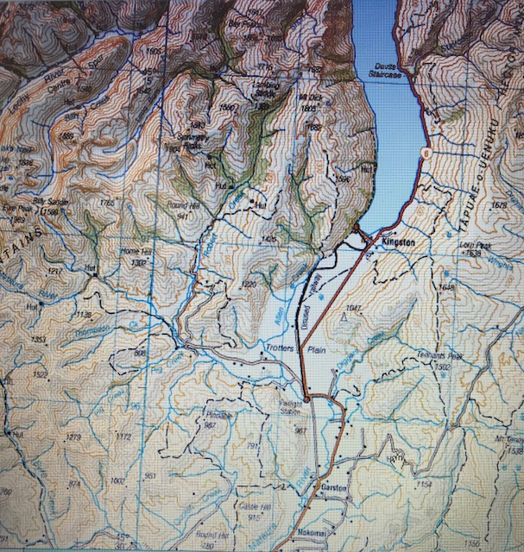
Fairlight to nokomai
Have to admit to not spending much time up this way in a number of years but…
generally single channel or minor braids but fair bit of faster deep water, short fast ripples and short fast holes. Still a lot of holding water and decent numbers of fish to spook.
Willow lined and quite a few ugly sections, tight fly thieving trees. Fish like these spots tho…
Pale green water, good stony bed in the main, shifty in some places, spring creek like in sections until Eyre creek and Quoich Creek, just out of Athol then it colours up a bit losing some of the “brightness”
Can get quite skinny in high summer temps and gets a fair bit of pressure from Garston up with relatively easy access across a paddock at worst.
There are a few huts at nokomai and as such this area also receives pressure and access can be difficult with plenty of willow around parawa
Often quite shifty bottom from here through into the gorge and its my experience that numbers reduce but the ones that do haunt this area are decent fish.

Slide 6
Nokomai to waikaia junction
Nokomai to cattle flat is on the to do list, a walk through here from the end of the cattle flat road to nokomai. Have to have a vehicle at the end and remember to take the keys out of the coat that you left in the car at cattle flat….
Cattle flat area is primo with nice flat runs, ripples galore, crumbly edges, holes, back waters, side braids etc. well worth a couple of days in this area and good numbers….and willows
Below cattle flat the tomogoluk stream area has some nice backwaters well worth exploring
The river here can be braided as it runs across the flats and the bottom is a bit shifty but still decent numbers of fish and worth exploring. Easy wading
Quite a few areas of wide shallow flats with grubbing fish in shallow water down to ardlussa
The waikaia enters around Waipounamu above riversdale and the colour changes to a more tannin stained. Some one once referred to it as “pale ale”

Slide 8
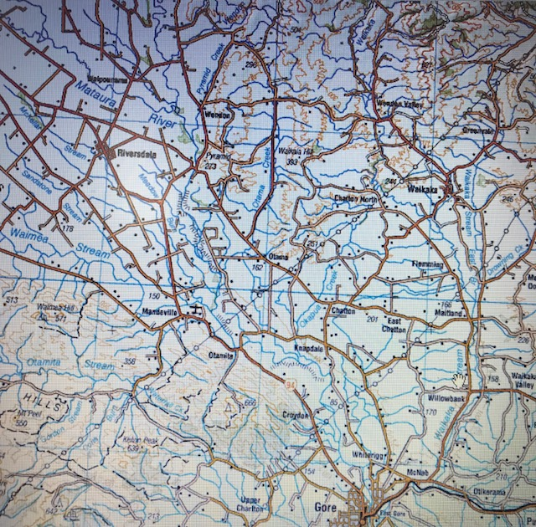
Waikaia junction to gore
Probably the second most fished section of river and certainly well worth spending a couple of days exploring around here. Theres a lot of river so spend some time with maps for best access options as they abound.
Good to High numbers of fish
Lots of smaller creeks and rivers entering that are worth a look ie otamita, Waimea
Good summer and autumn hatches, perhaps of shorter duration than in the past and perhaps less reliable
Generally single channel and able to be crossed in normal flows but often not needed
Often grassy banked….bliss on the feet after Canterbury rocky beds

Slide 9
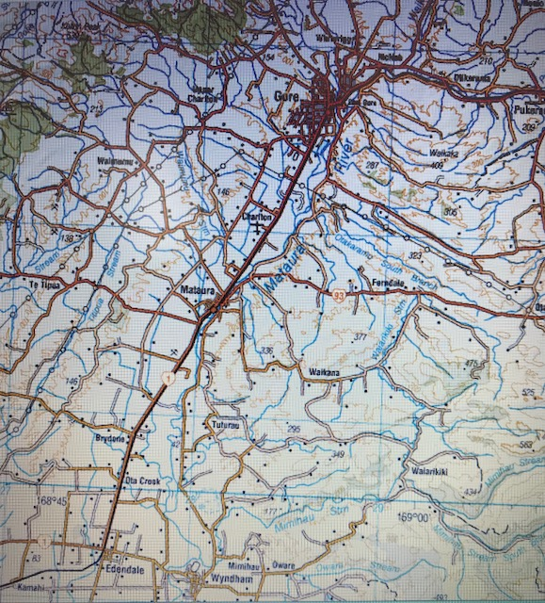
Gore to wyndham
most fished section of river but for good reason. Lots and lots of target species. certainly well worth spending a couple of days exploring around here.
Again Good to High numbers of fish and some large specimens incl trophy fish but tough!
In my experience the most prolific area for hatches, again reduced perhaps on what they were but get the day and the stars aligned and you wont move your feet.
Generally single channel and able to be crossed easily in normal flows but often not needed
Again lots of grass banks and often grazed with hot wires at fly catching level. Plenty of willow but easy to be all day in the river

Slide 10
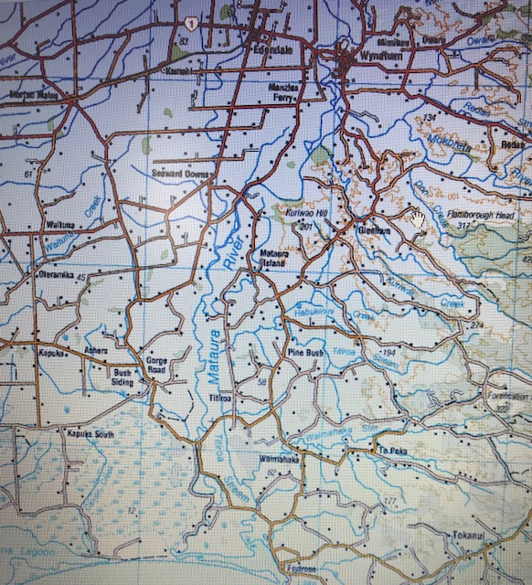
Wyndham to the sea
Yeah…. Its ok but gets quite big and slow and boring.
There are some really nice reaches but once you get to matuara island area it’s a bit blah.
Open all year from gorge road bridge to the sea. Often goes off with sea runners smashing whitebait if that’s your thing. At whitebait time there are a zillion camper vans and caravans
Never ever fished the estuary and probably never will but im told that its worth it as long as its not blowing straight from the south pole….often is.

Slide 11
gear
4-6 wgt rod – med fast action is my preference but something that will deliver a 16 spinner like thistle down or a twin bead head rig quickly from a roll cast
Wgt forward line and a decent reel. Doesn’t need to be the best on the market, many fish will be played off the hand and get net close before all the string is on the reel.
12-15’ tapered leader with 3-5’ tippet. 6lb tippet 90% of the time but may have to drop to 3/4lb. Carry some mono tippet as well as flouro
Good wading boots with cleats recommended
Wet wading jan through early march especially if covering some distance
Waders often good idea in lower reaches where you could be fishing one pool all day and often need to stand deeper.
Dull coloured clothing an absolute must and no sparkly bits

Slide 12
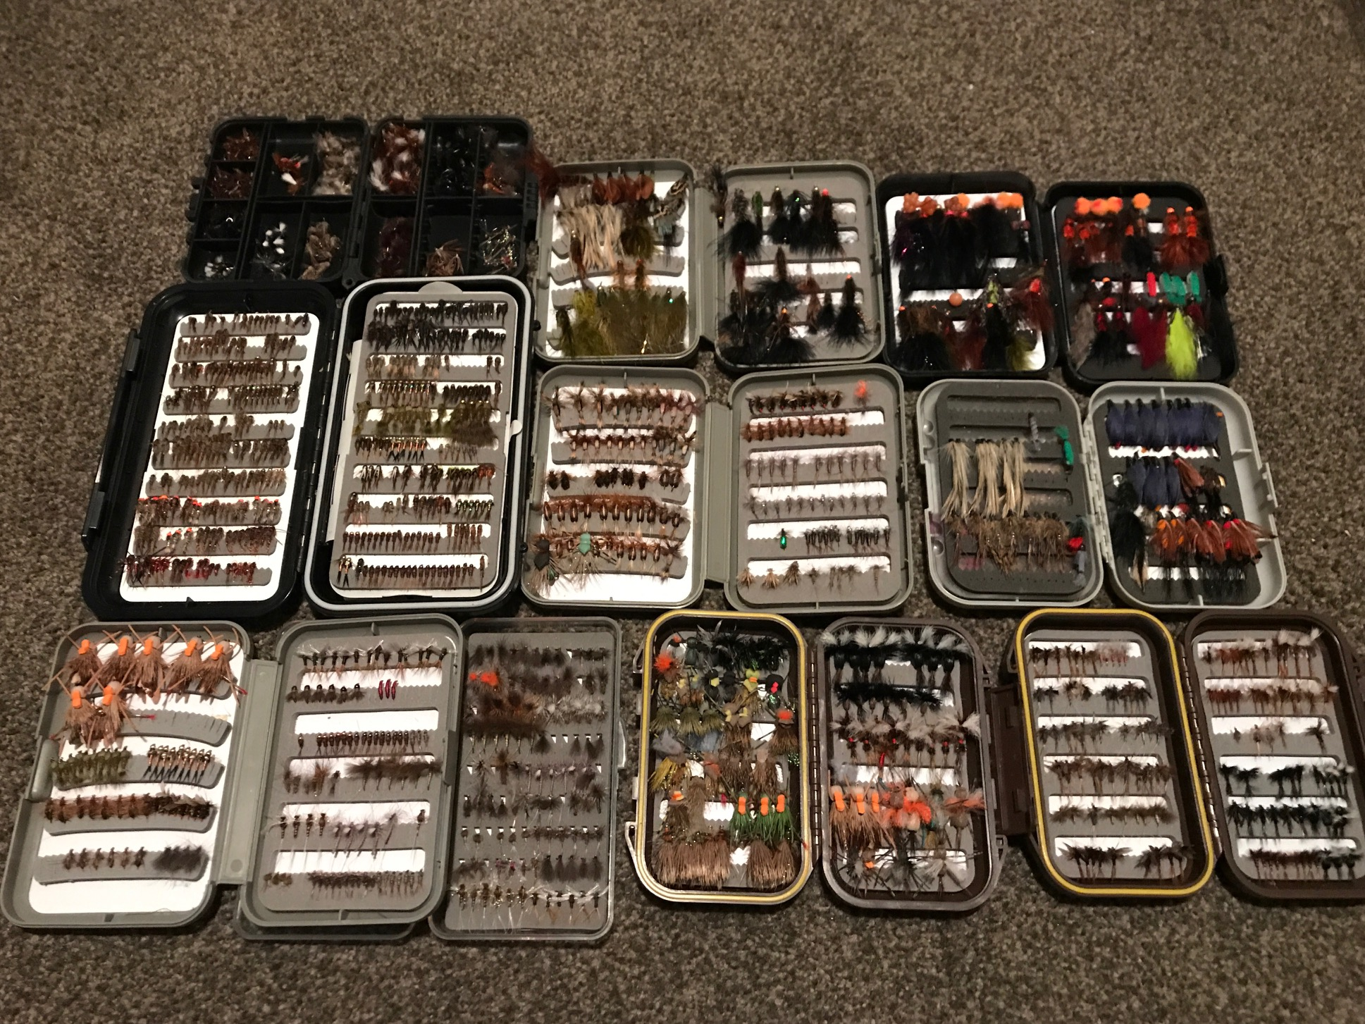
Flies

Slide 13
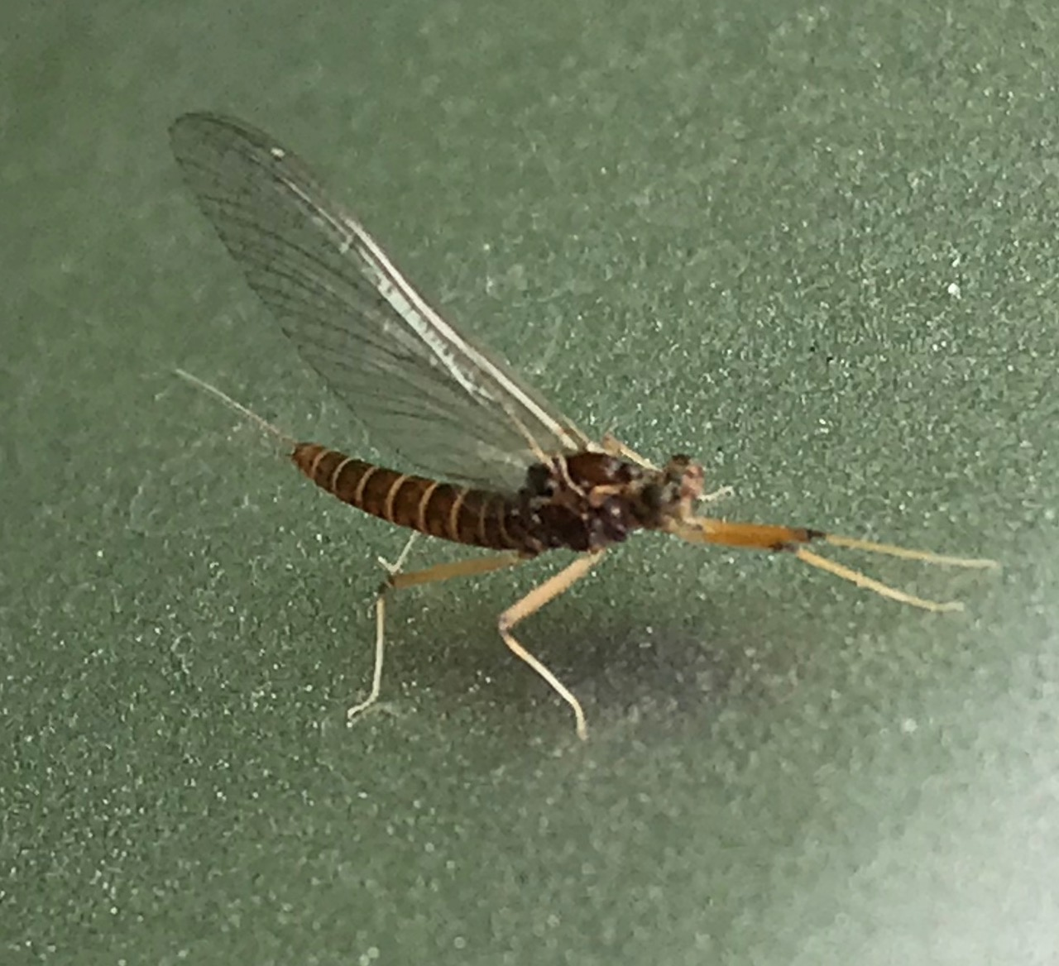
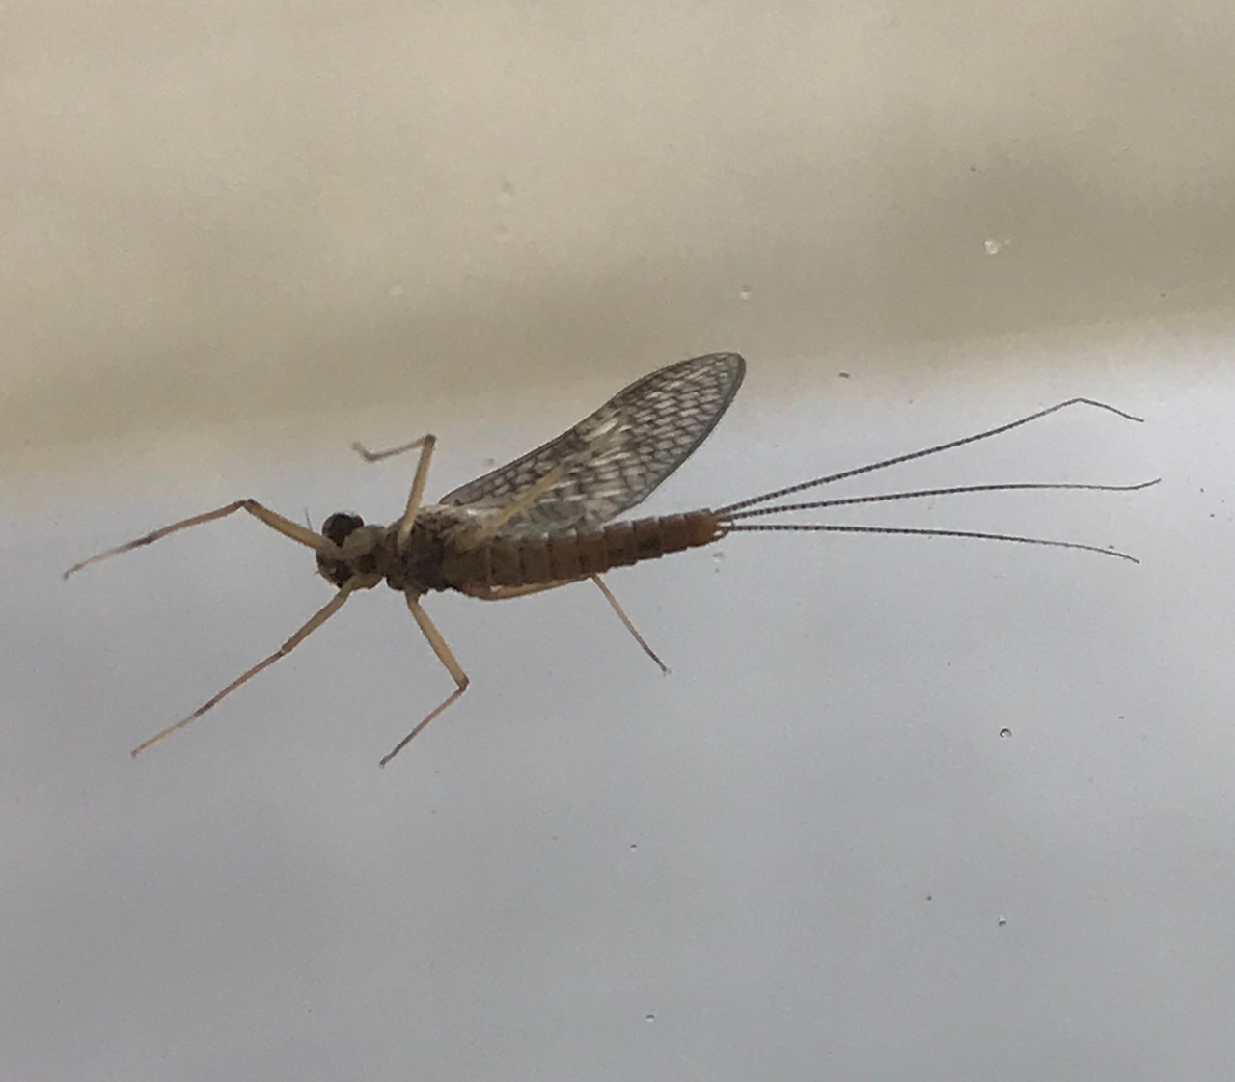
Dry fly!! Emergers, duns and spinners

Slide 14
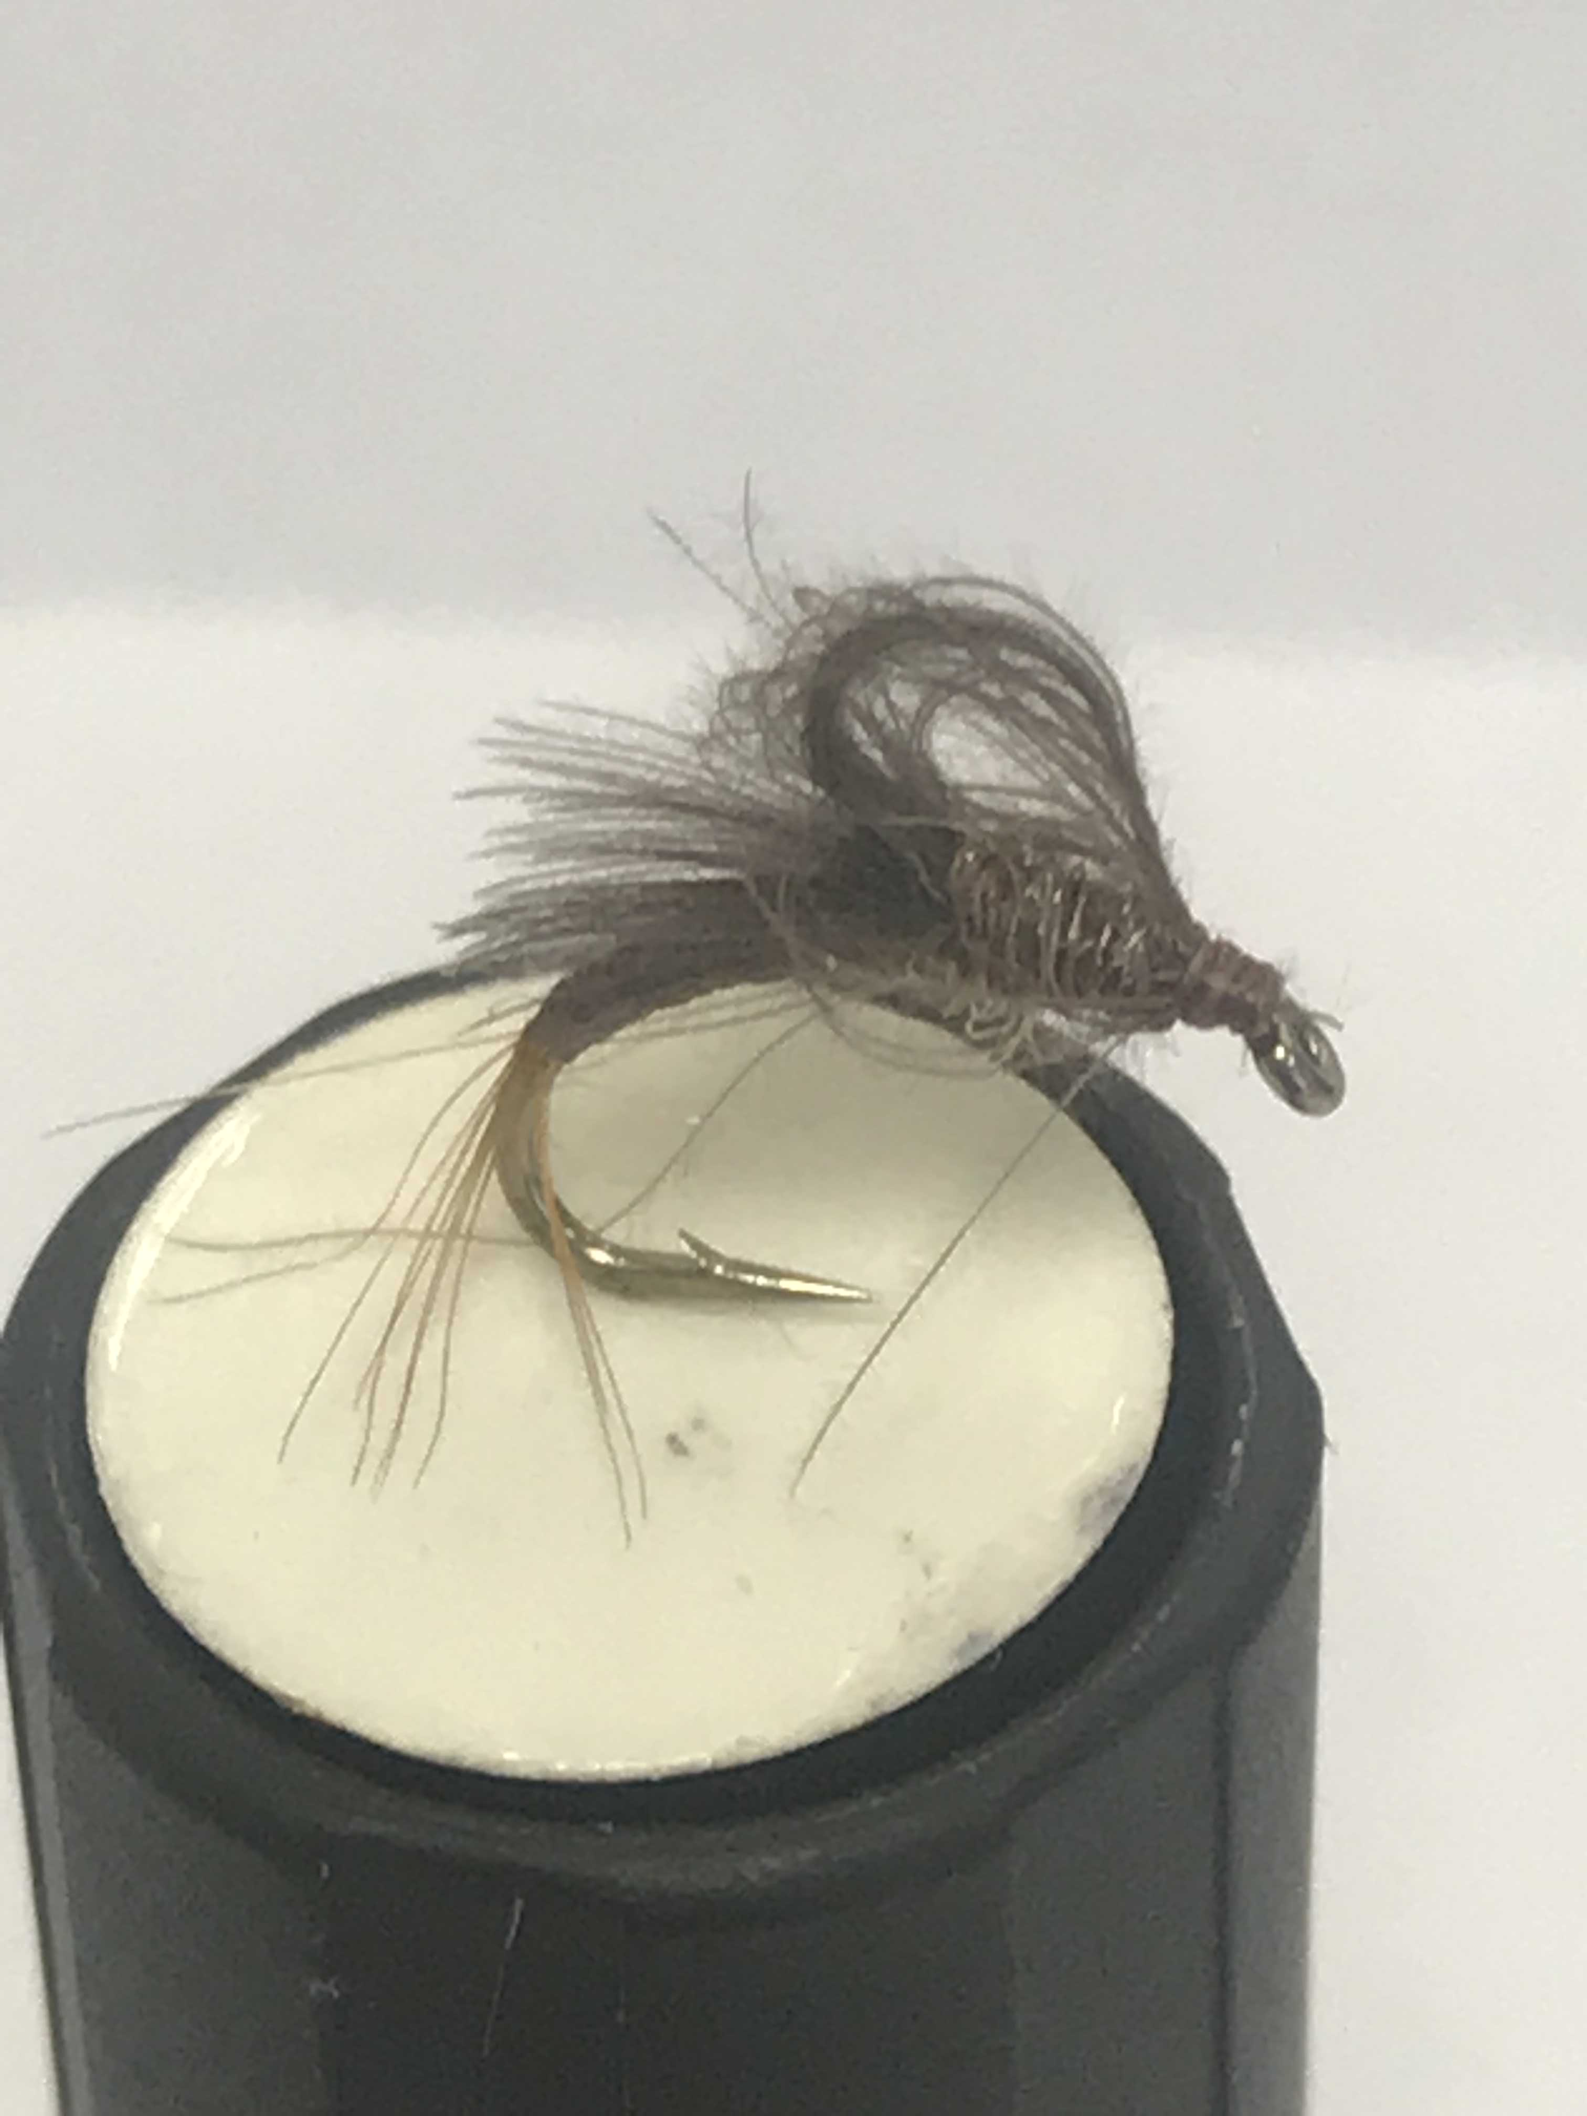
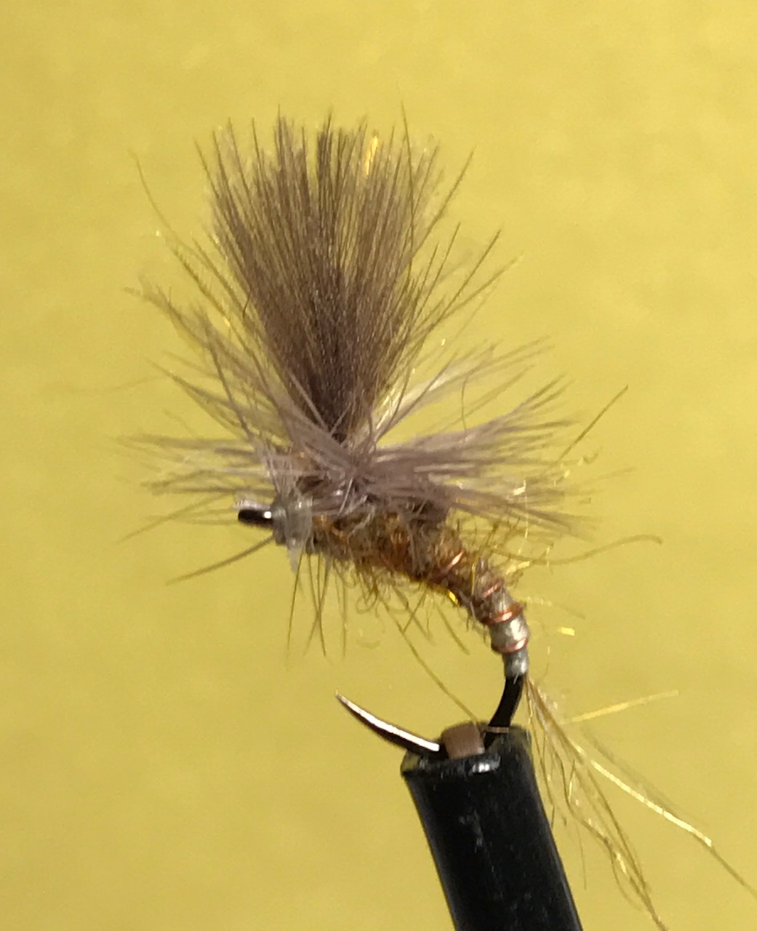
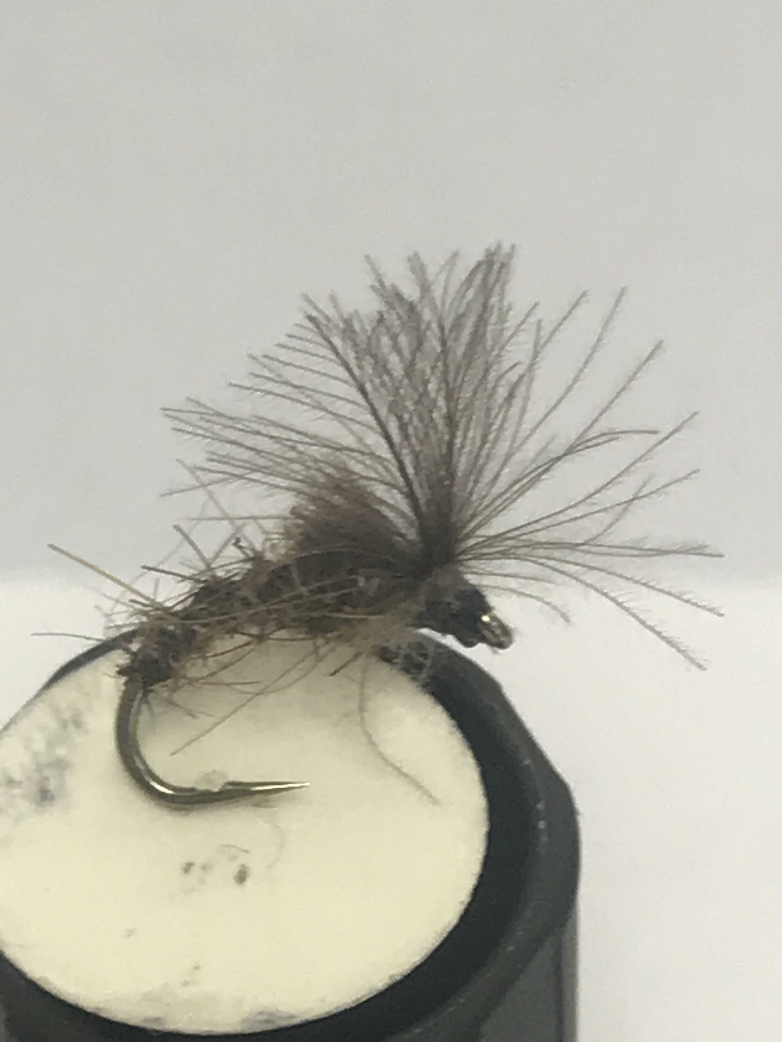
emergers

Slide 15
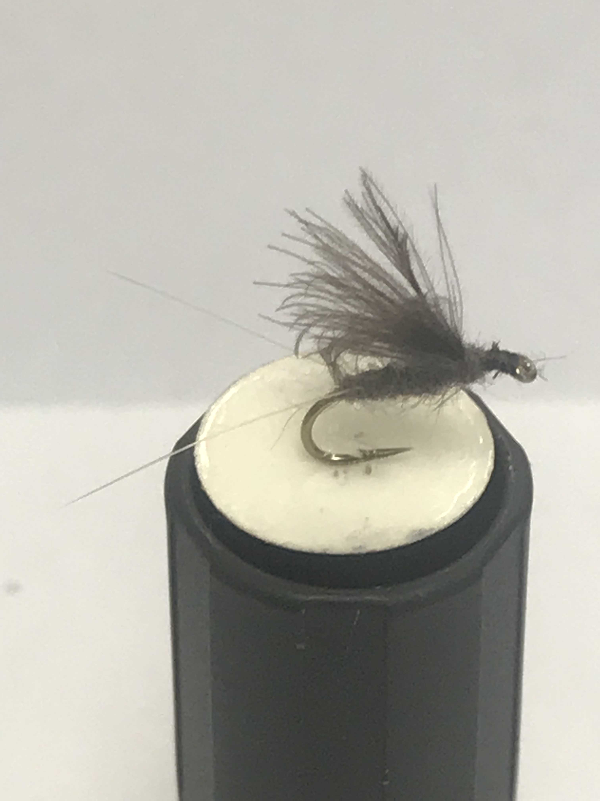
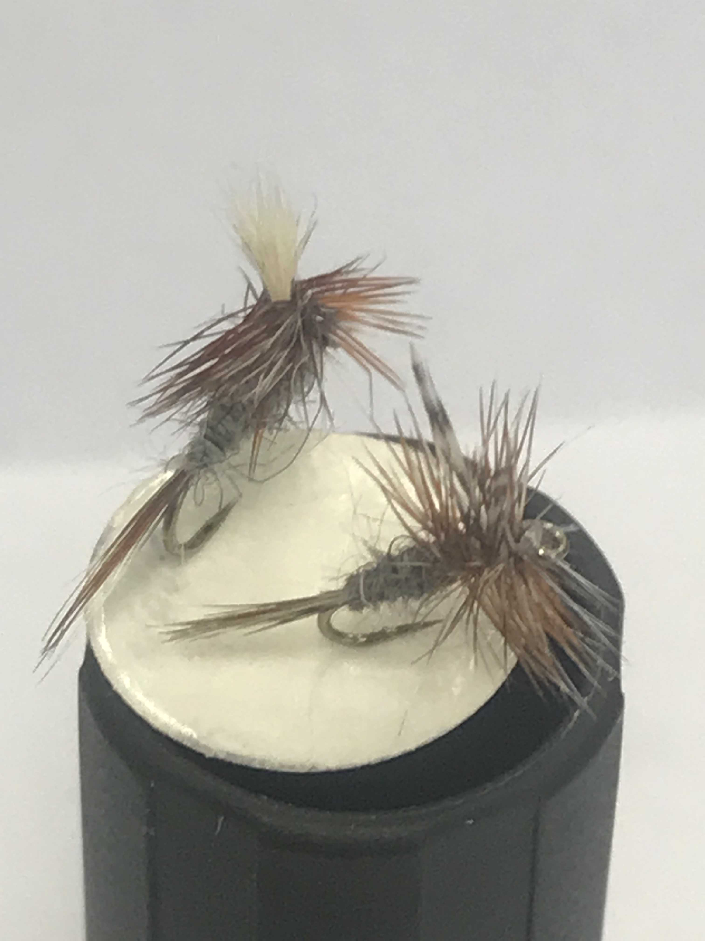
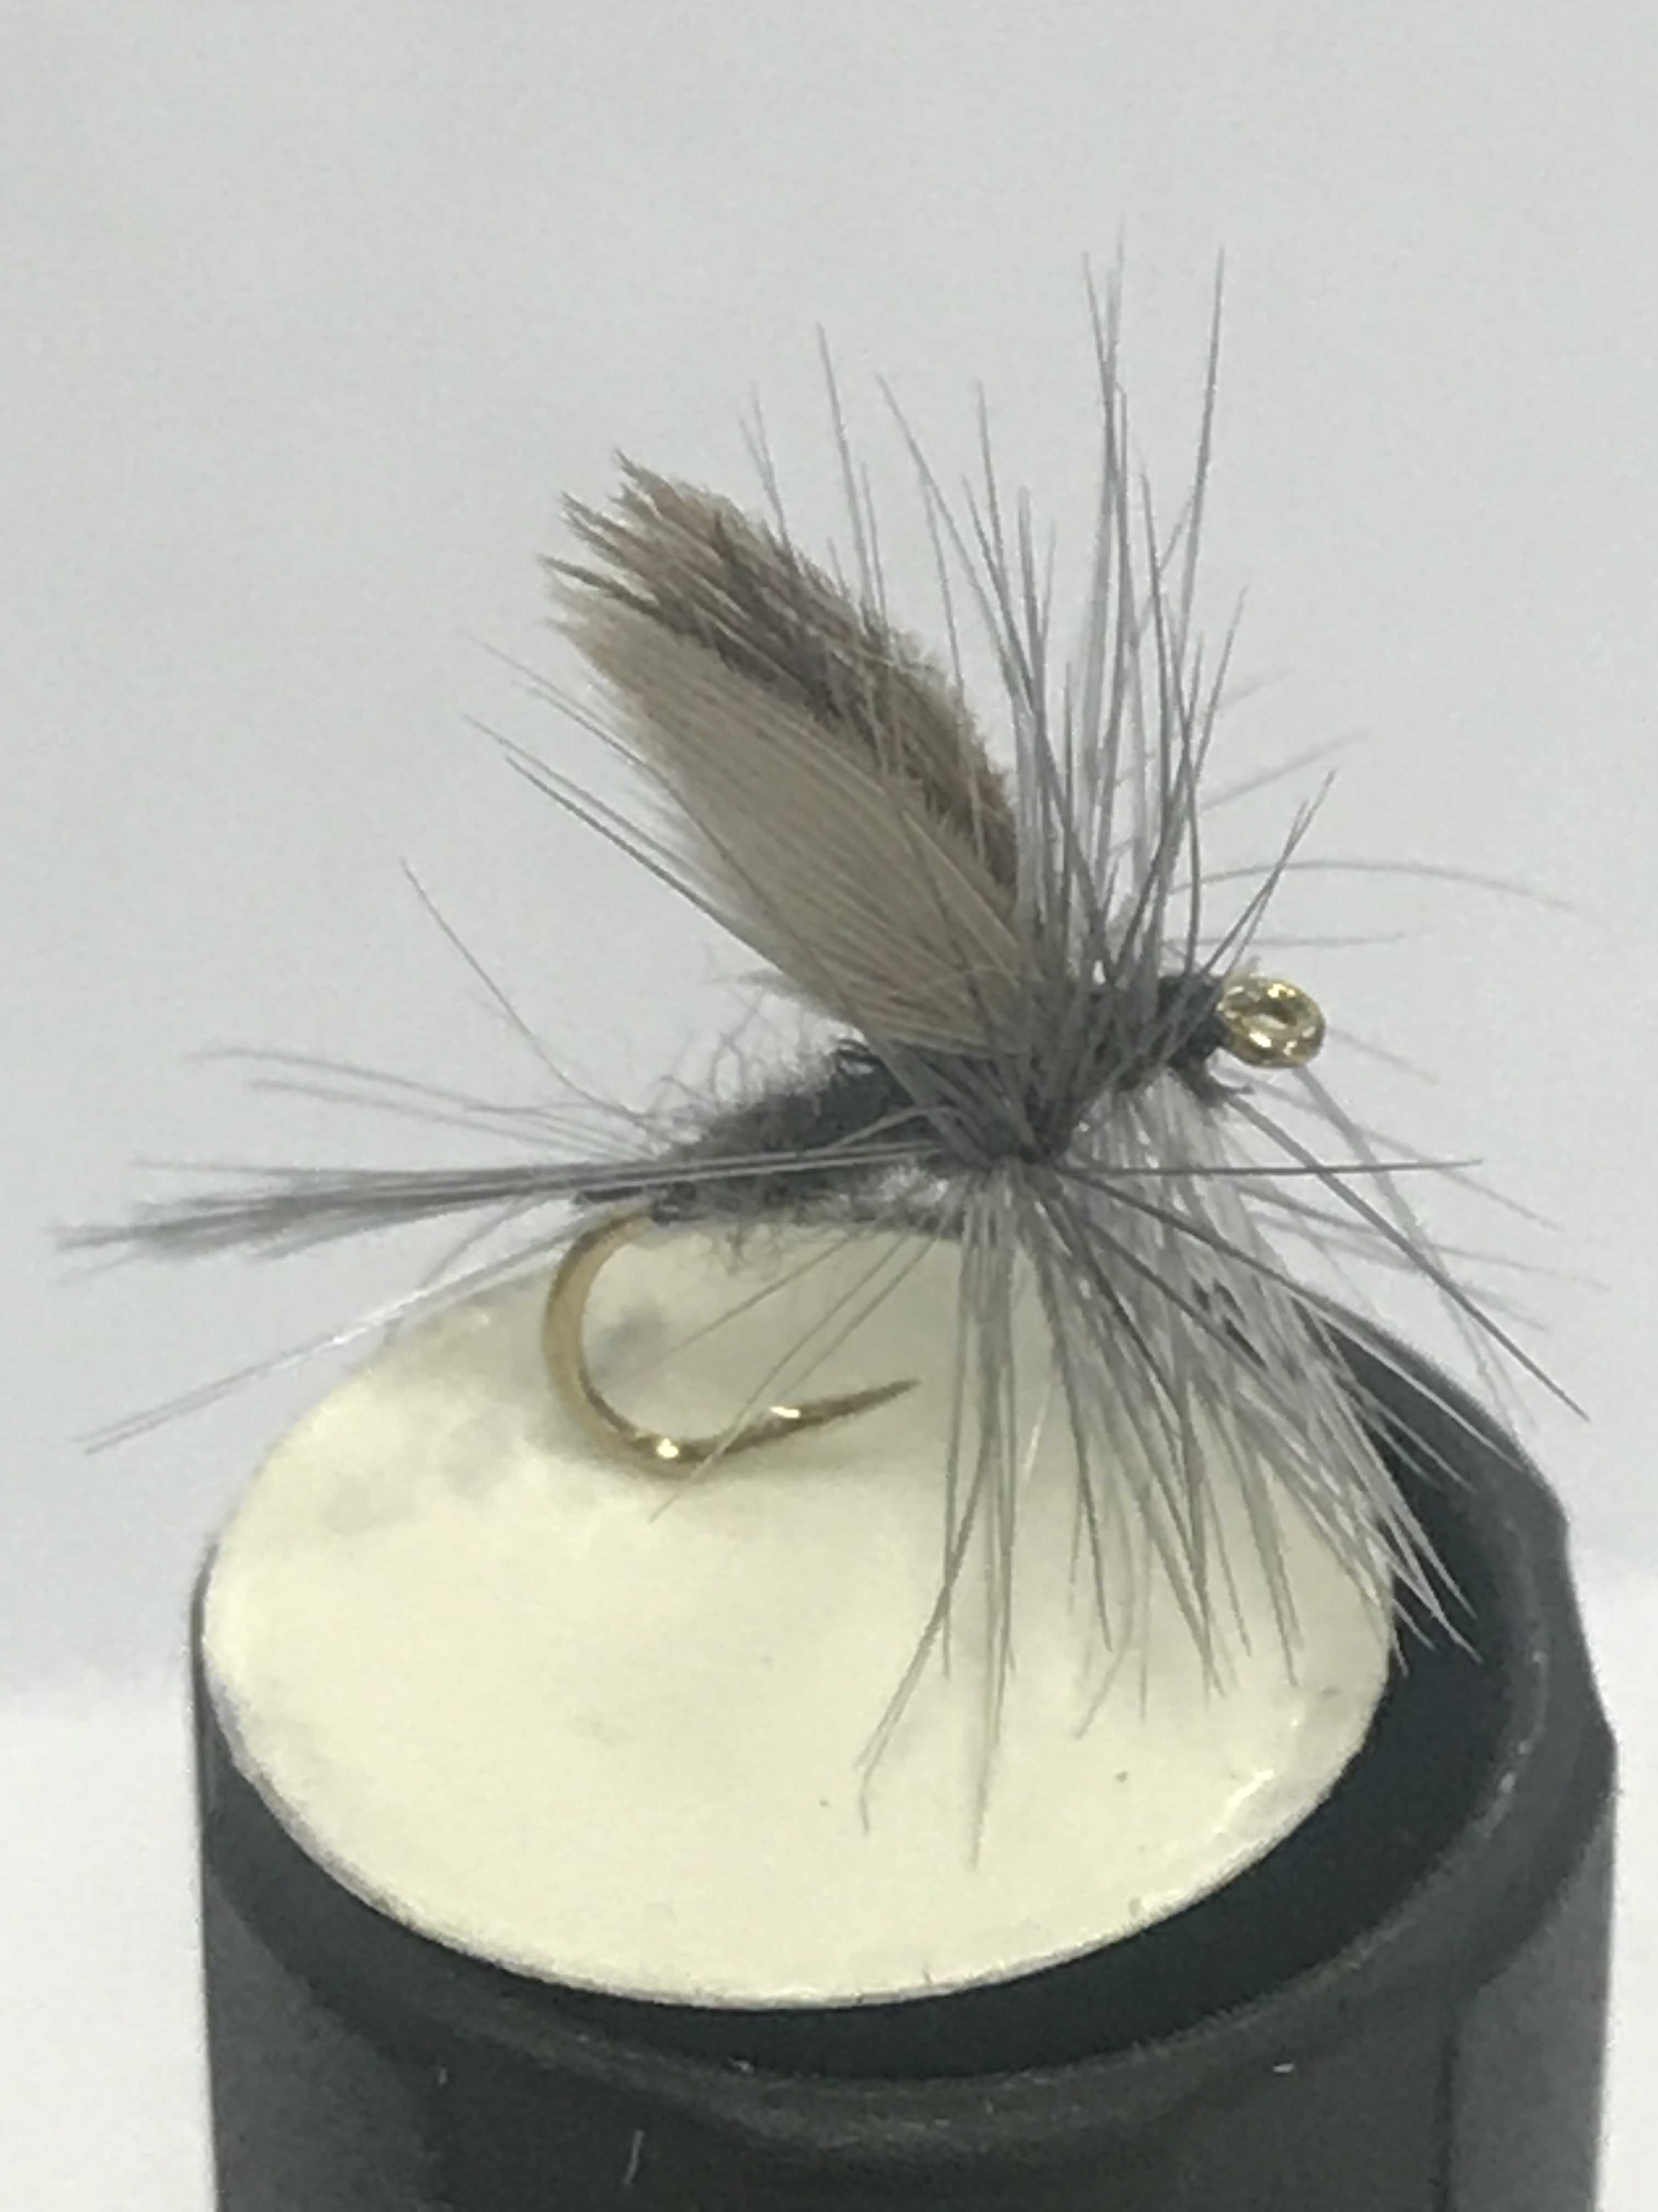
Duns

Slide 16
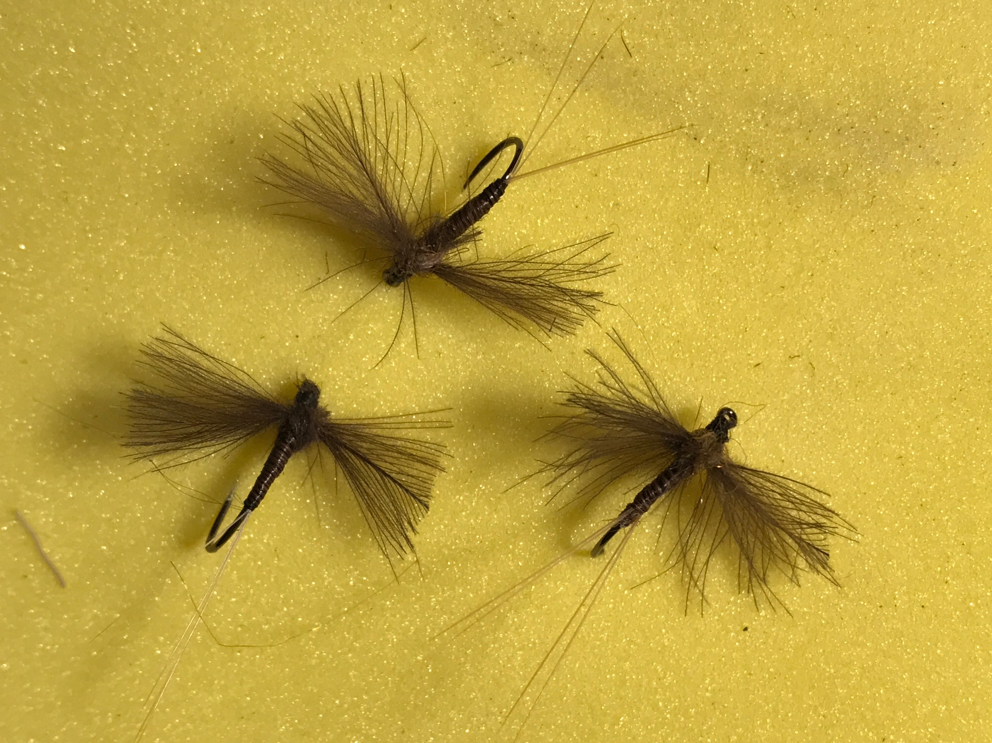
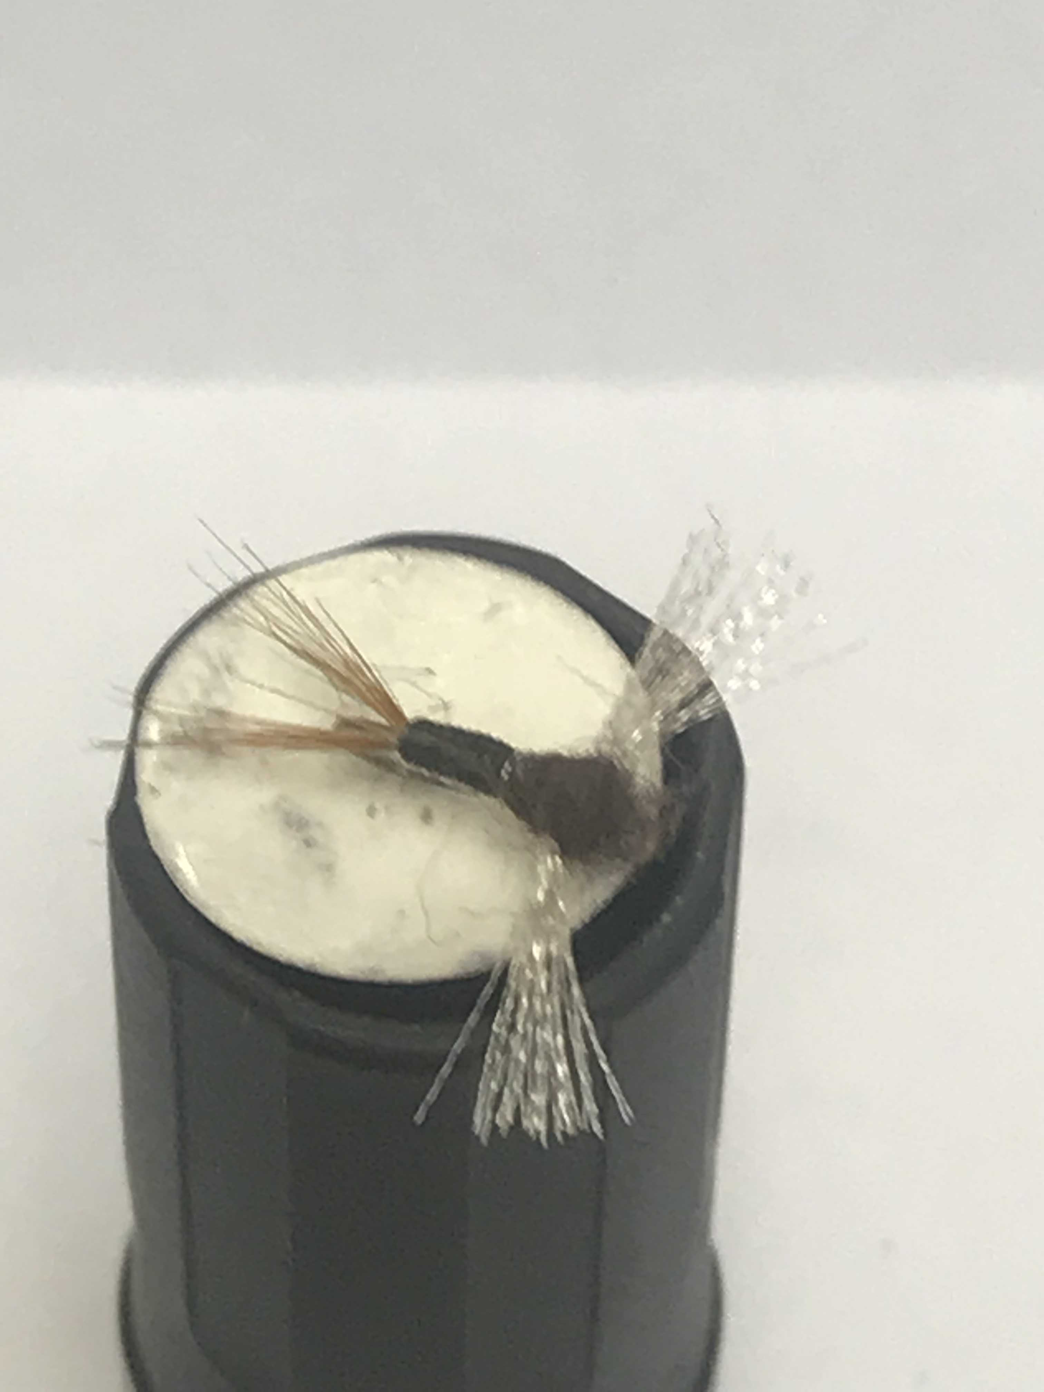
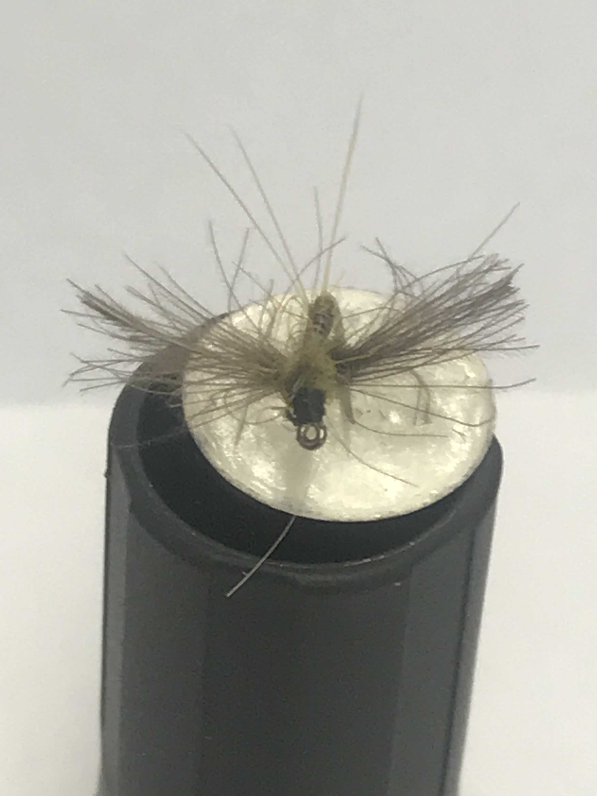
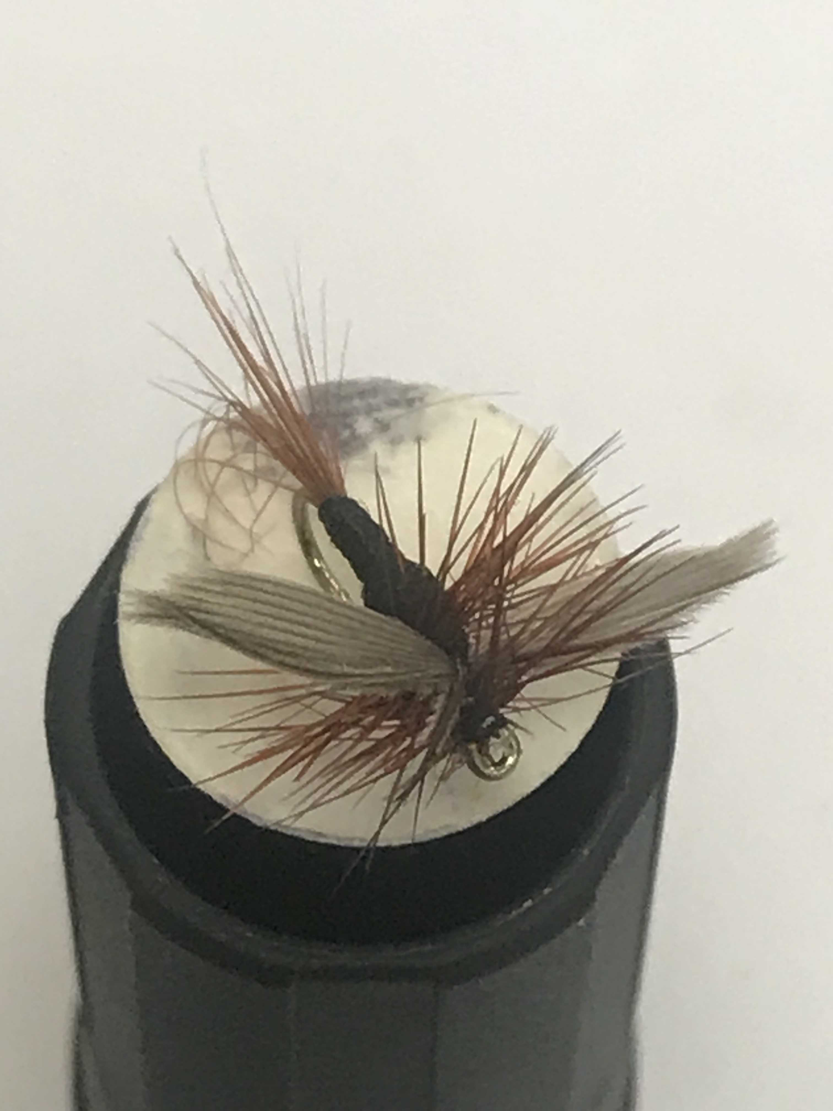
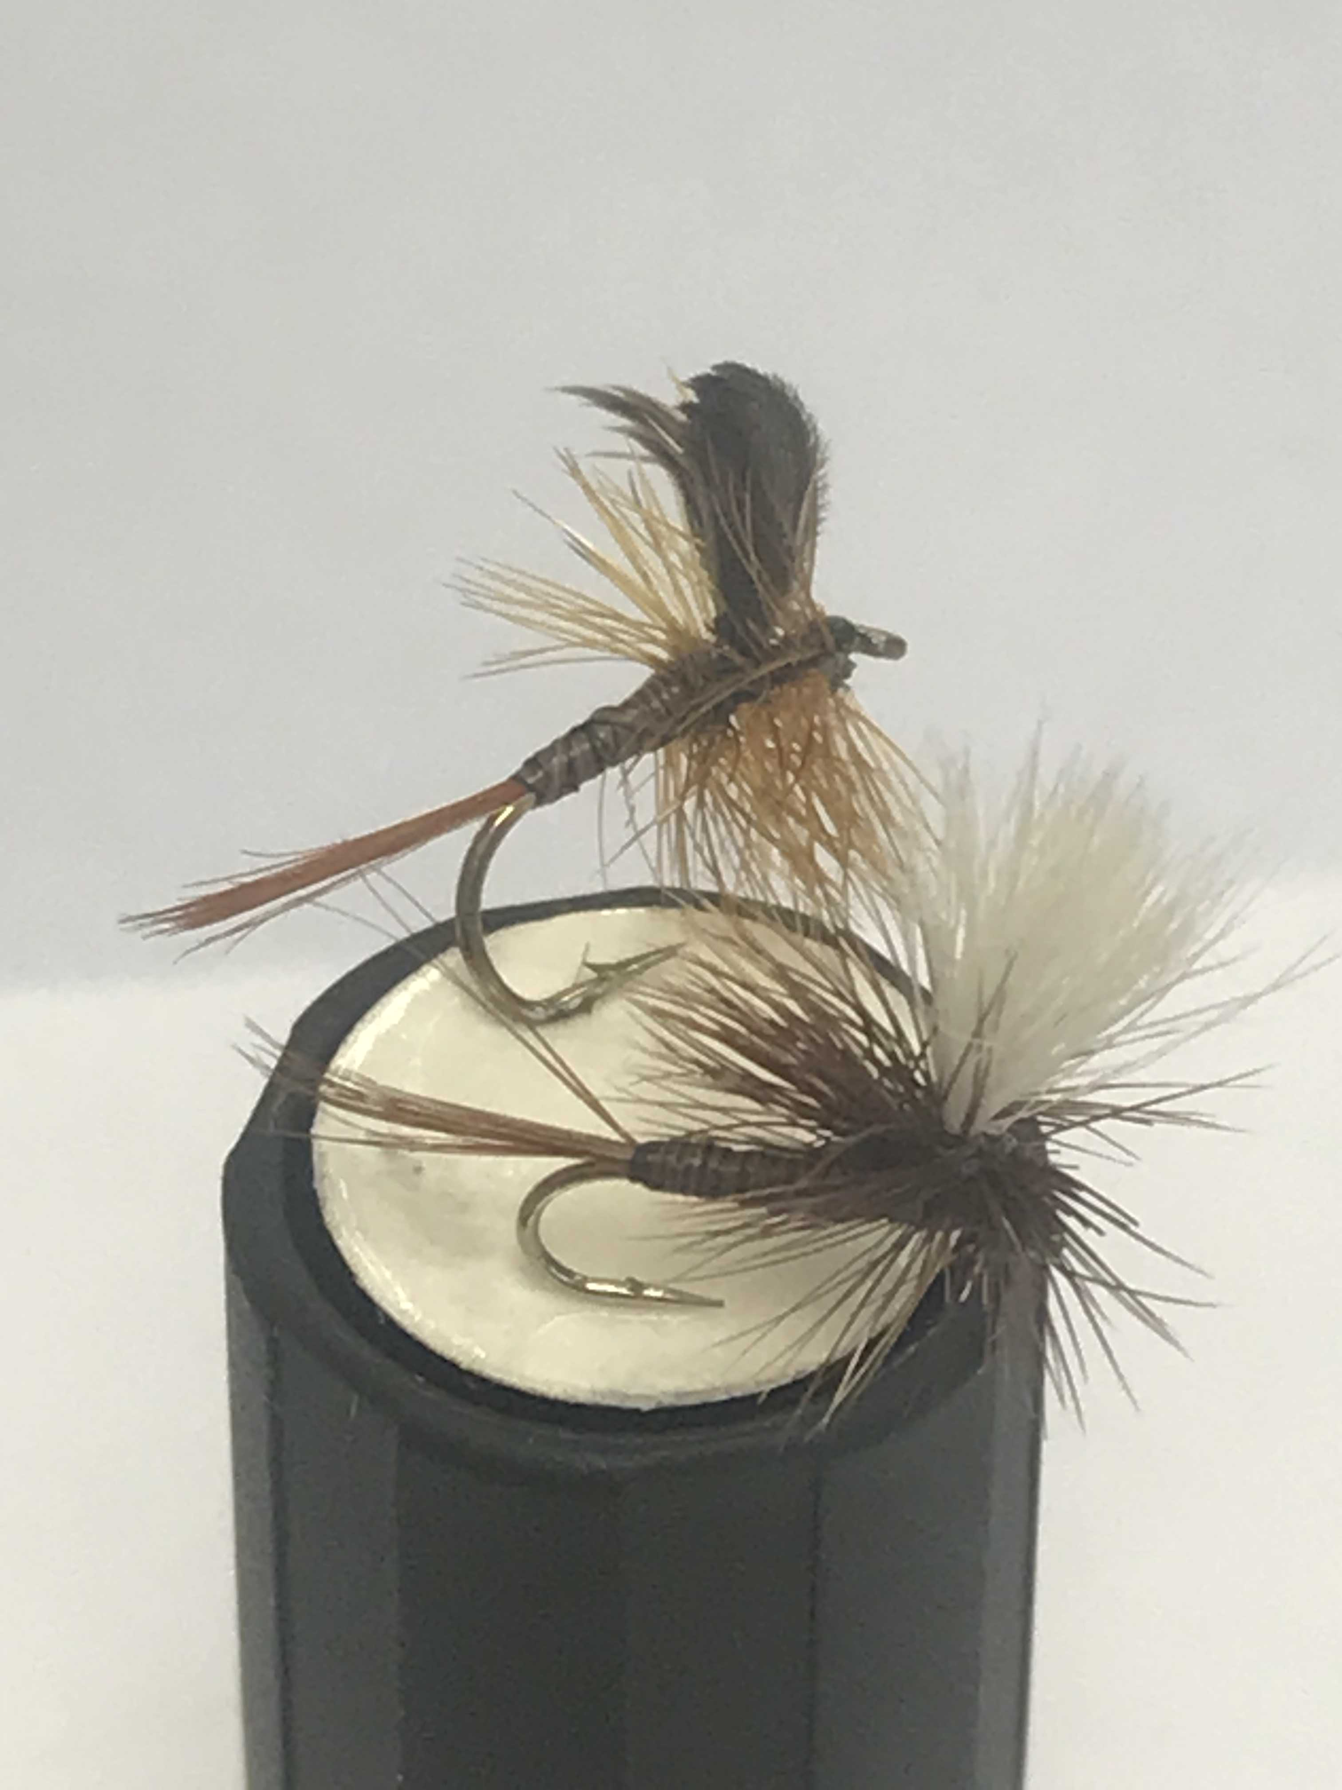
Spinners

Slide 17
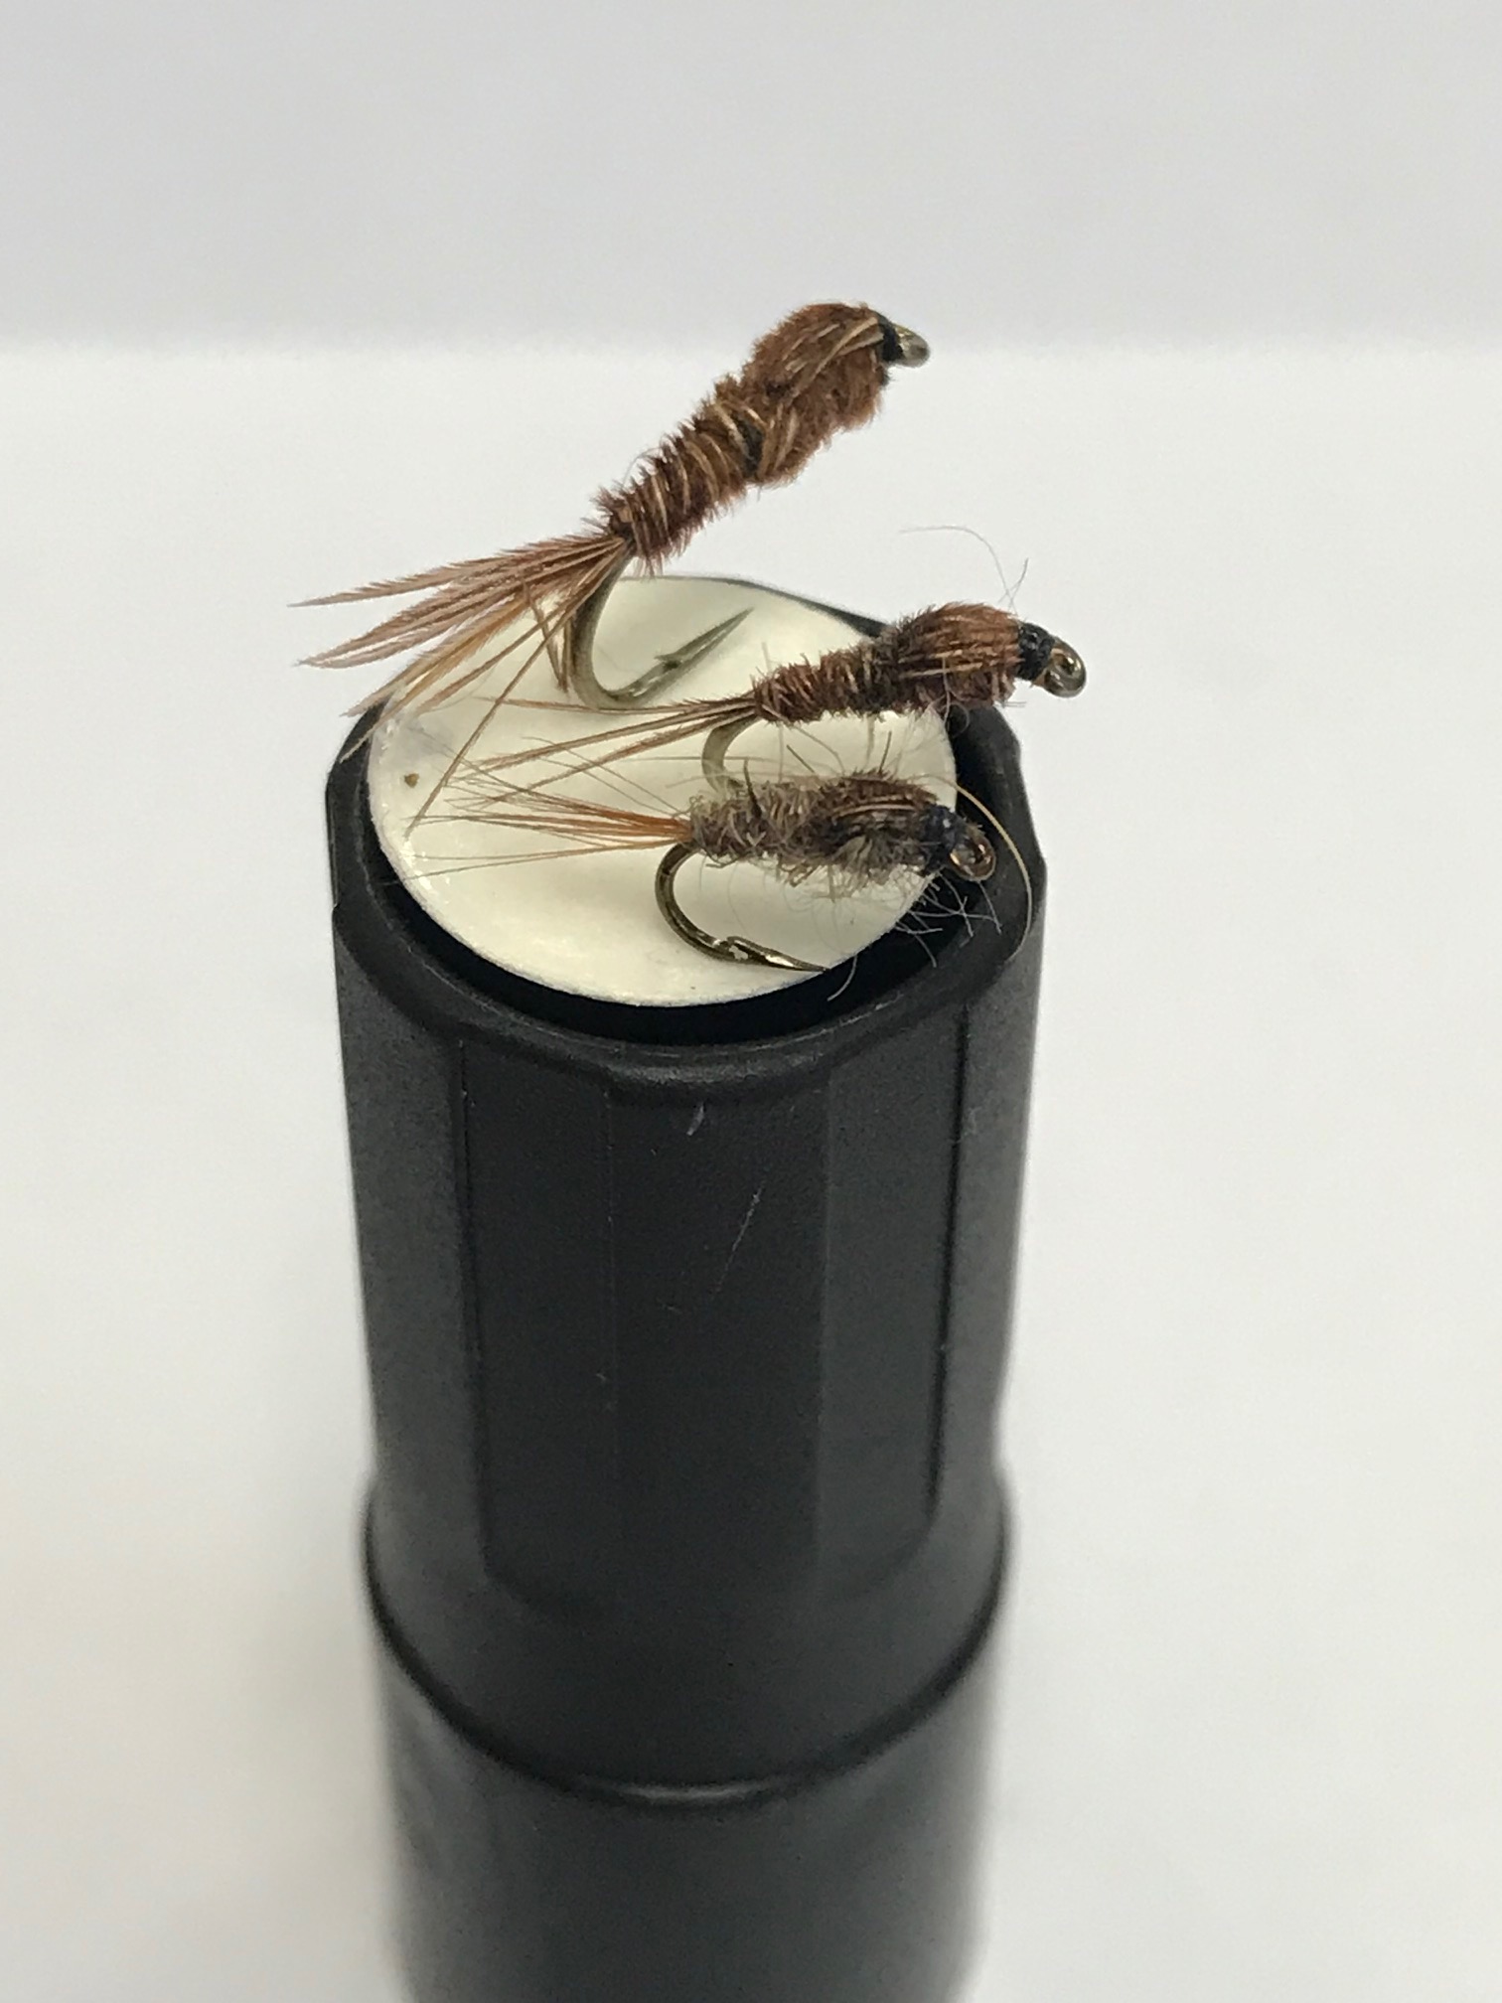
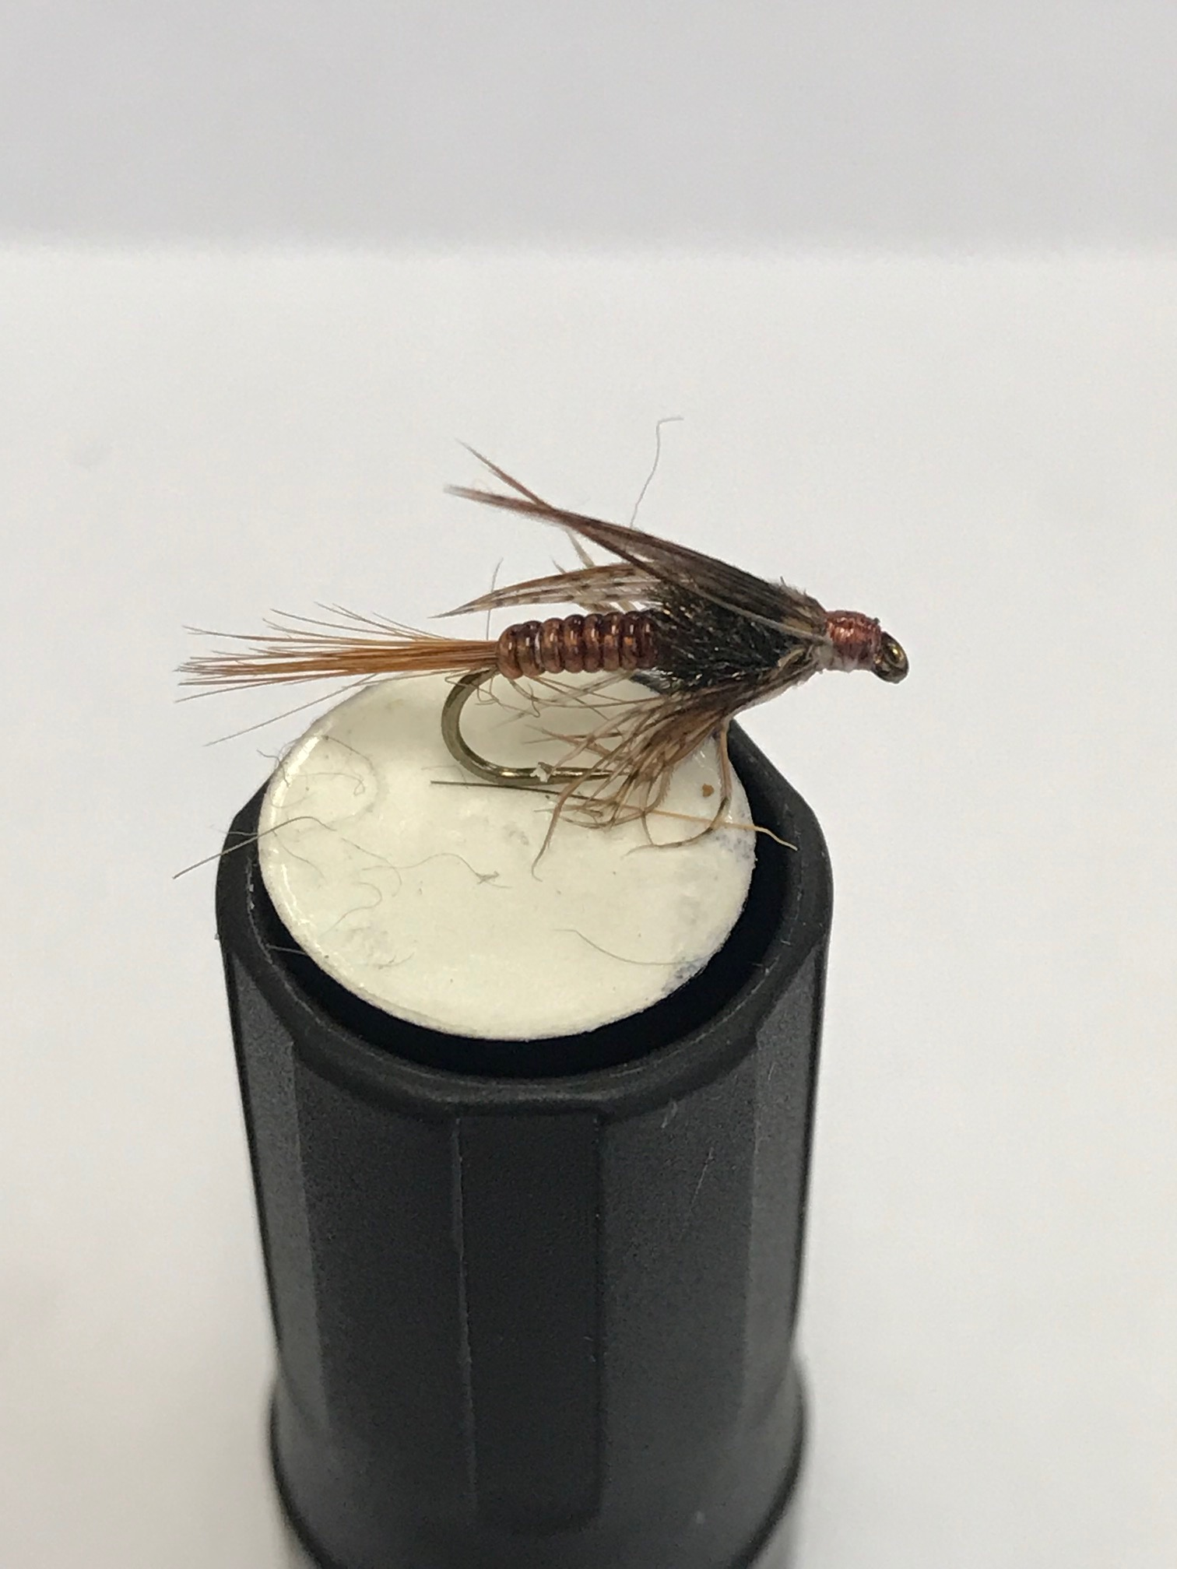
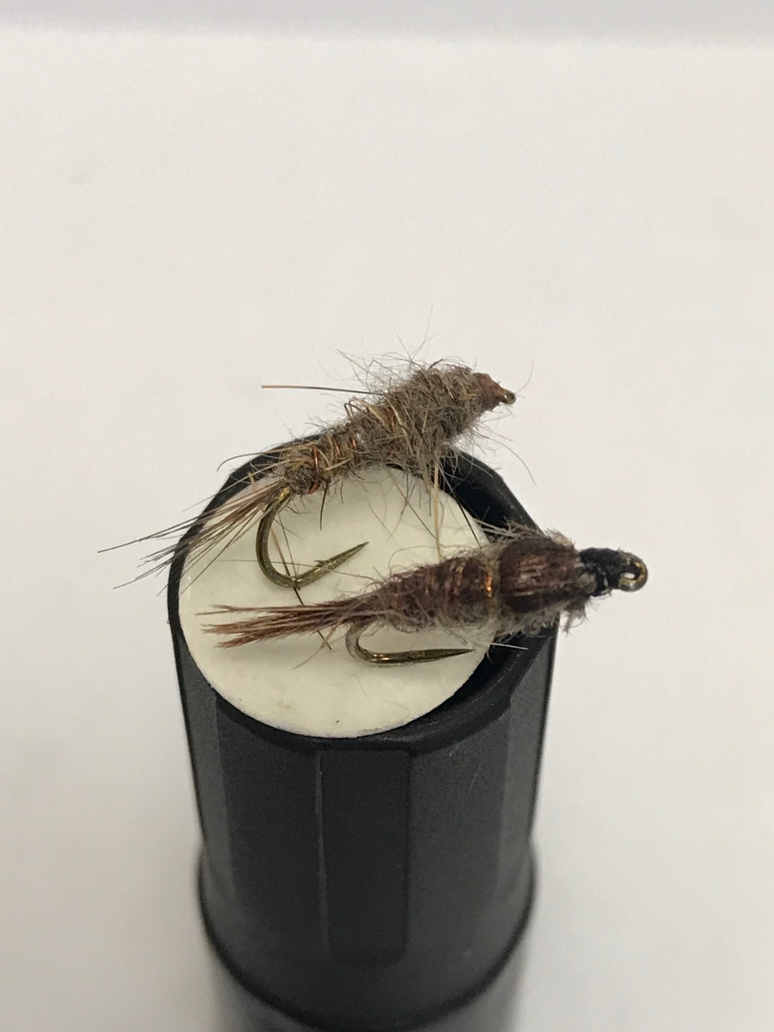
Nymphs – unweighted and weighted

Slide 18
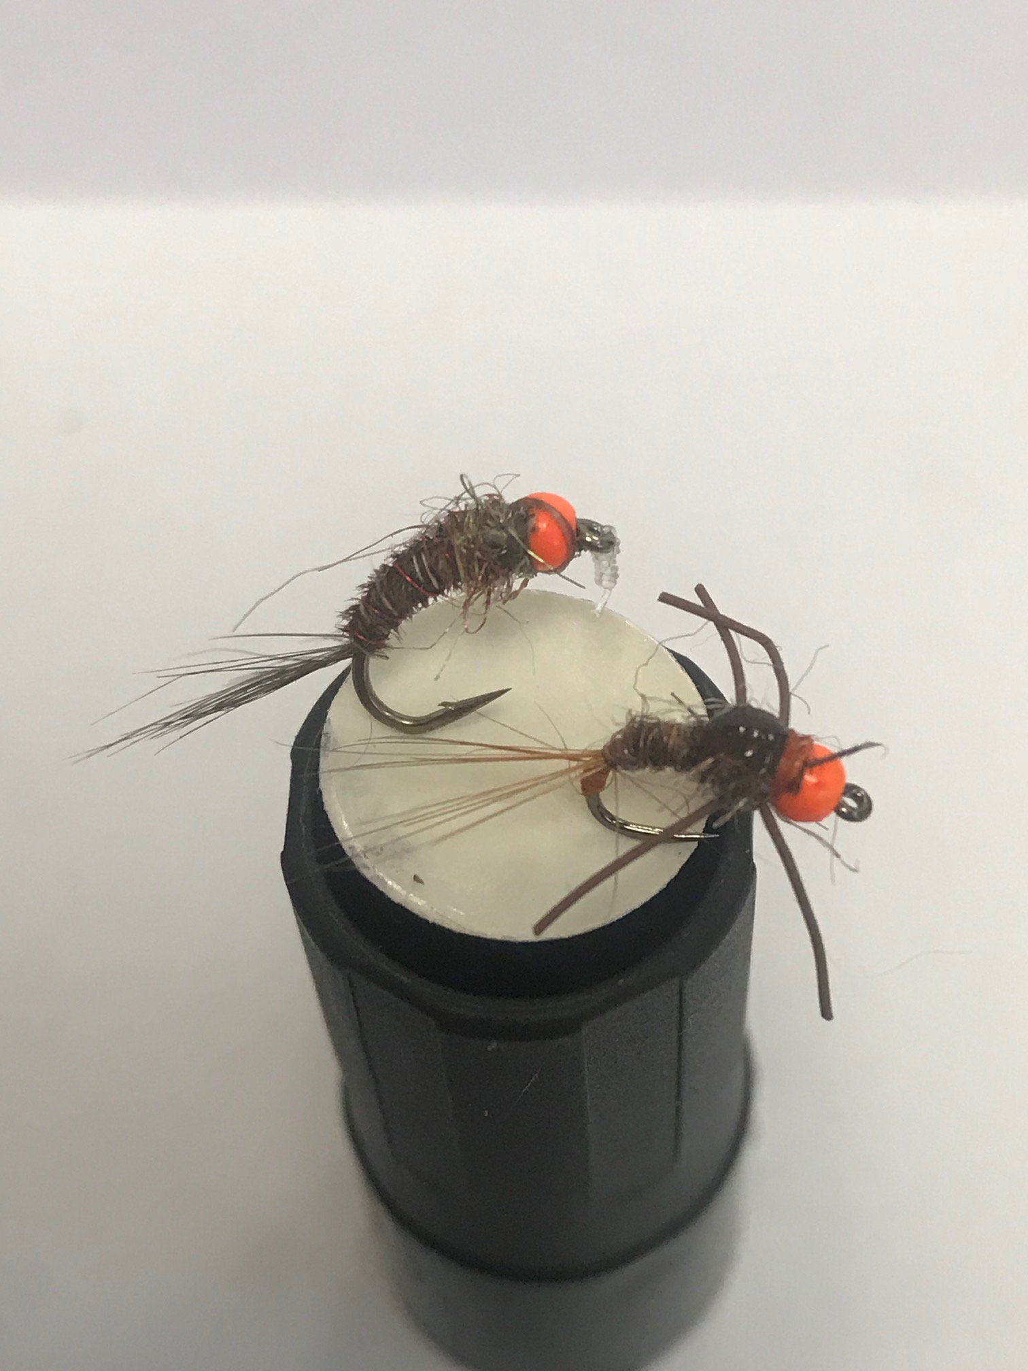
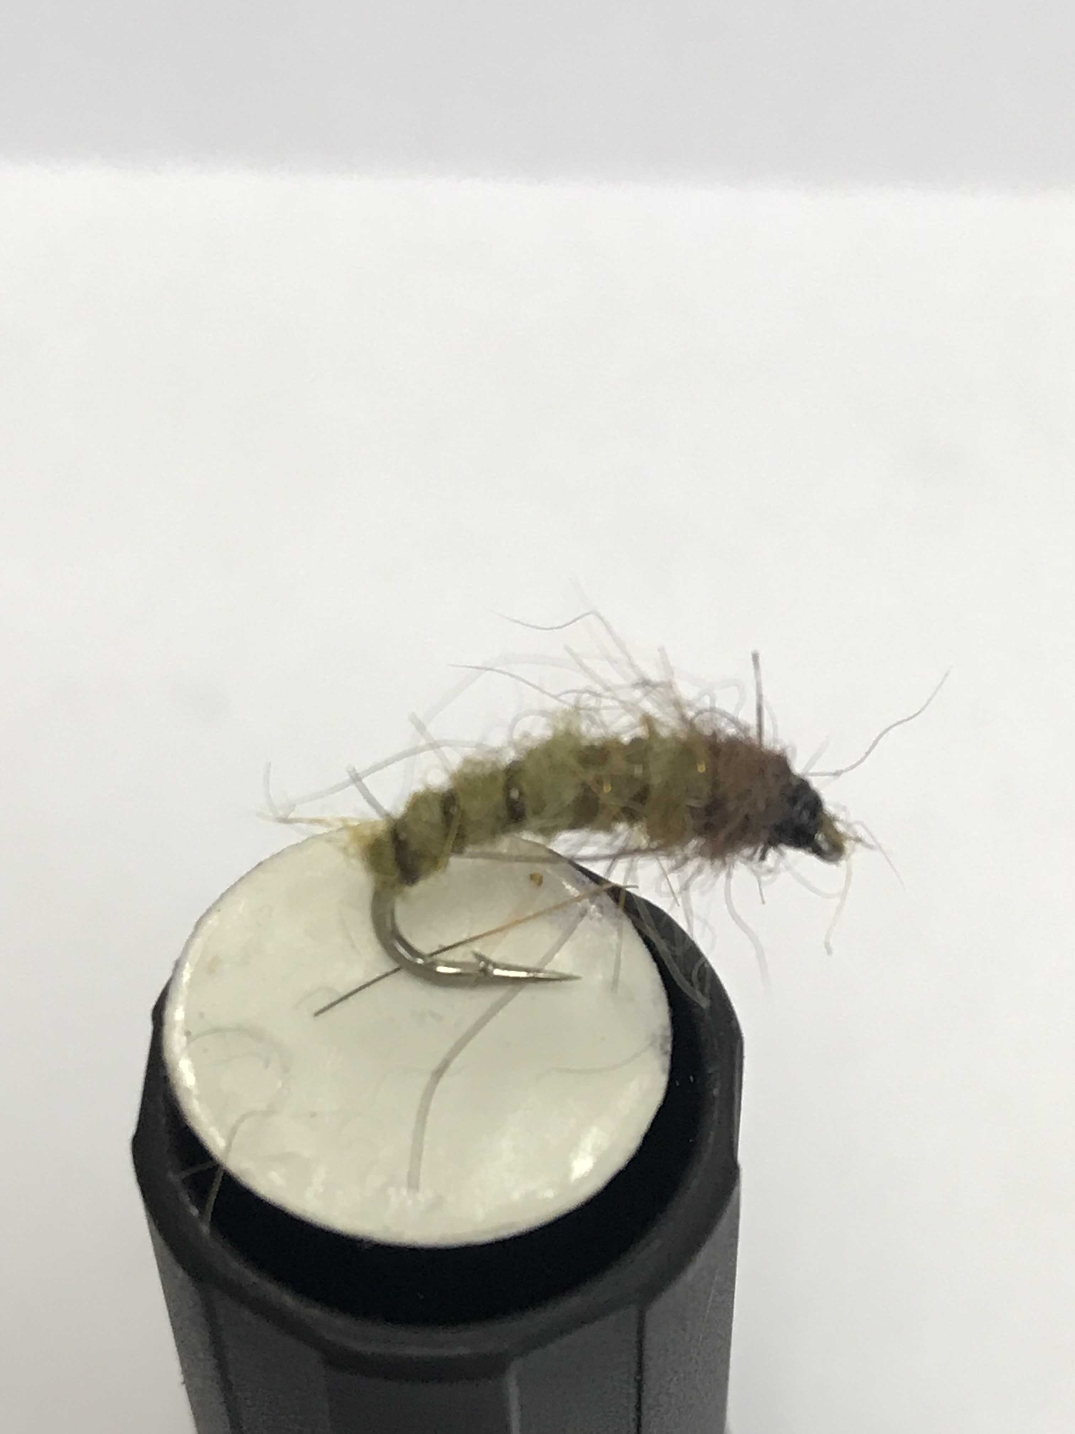
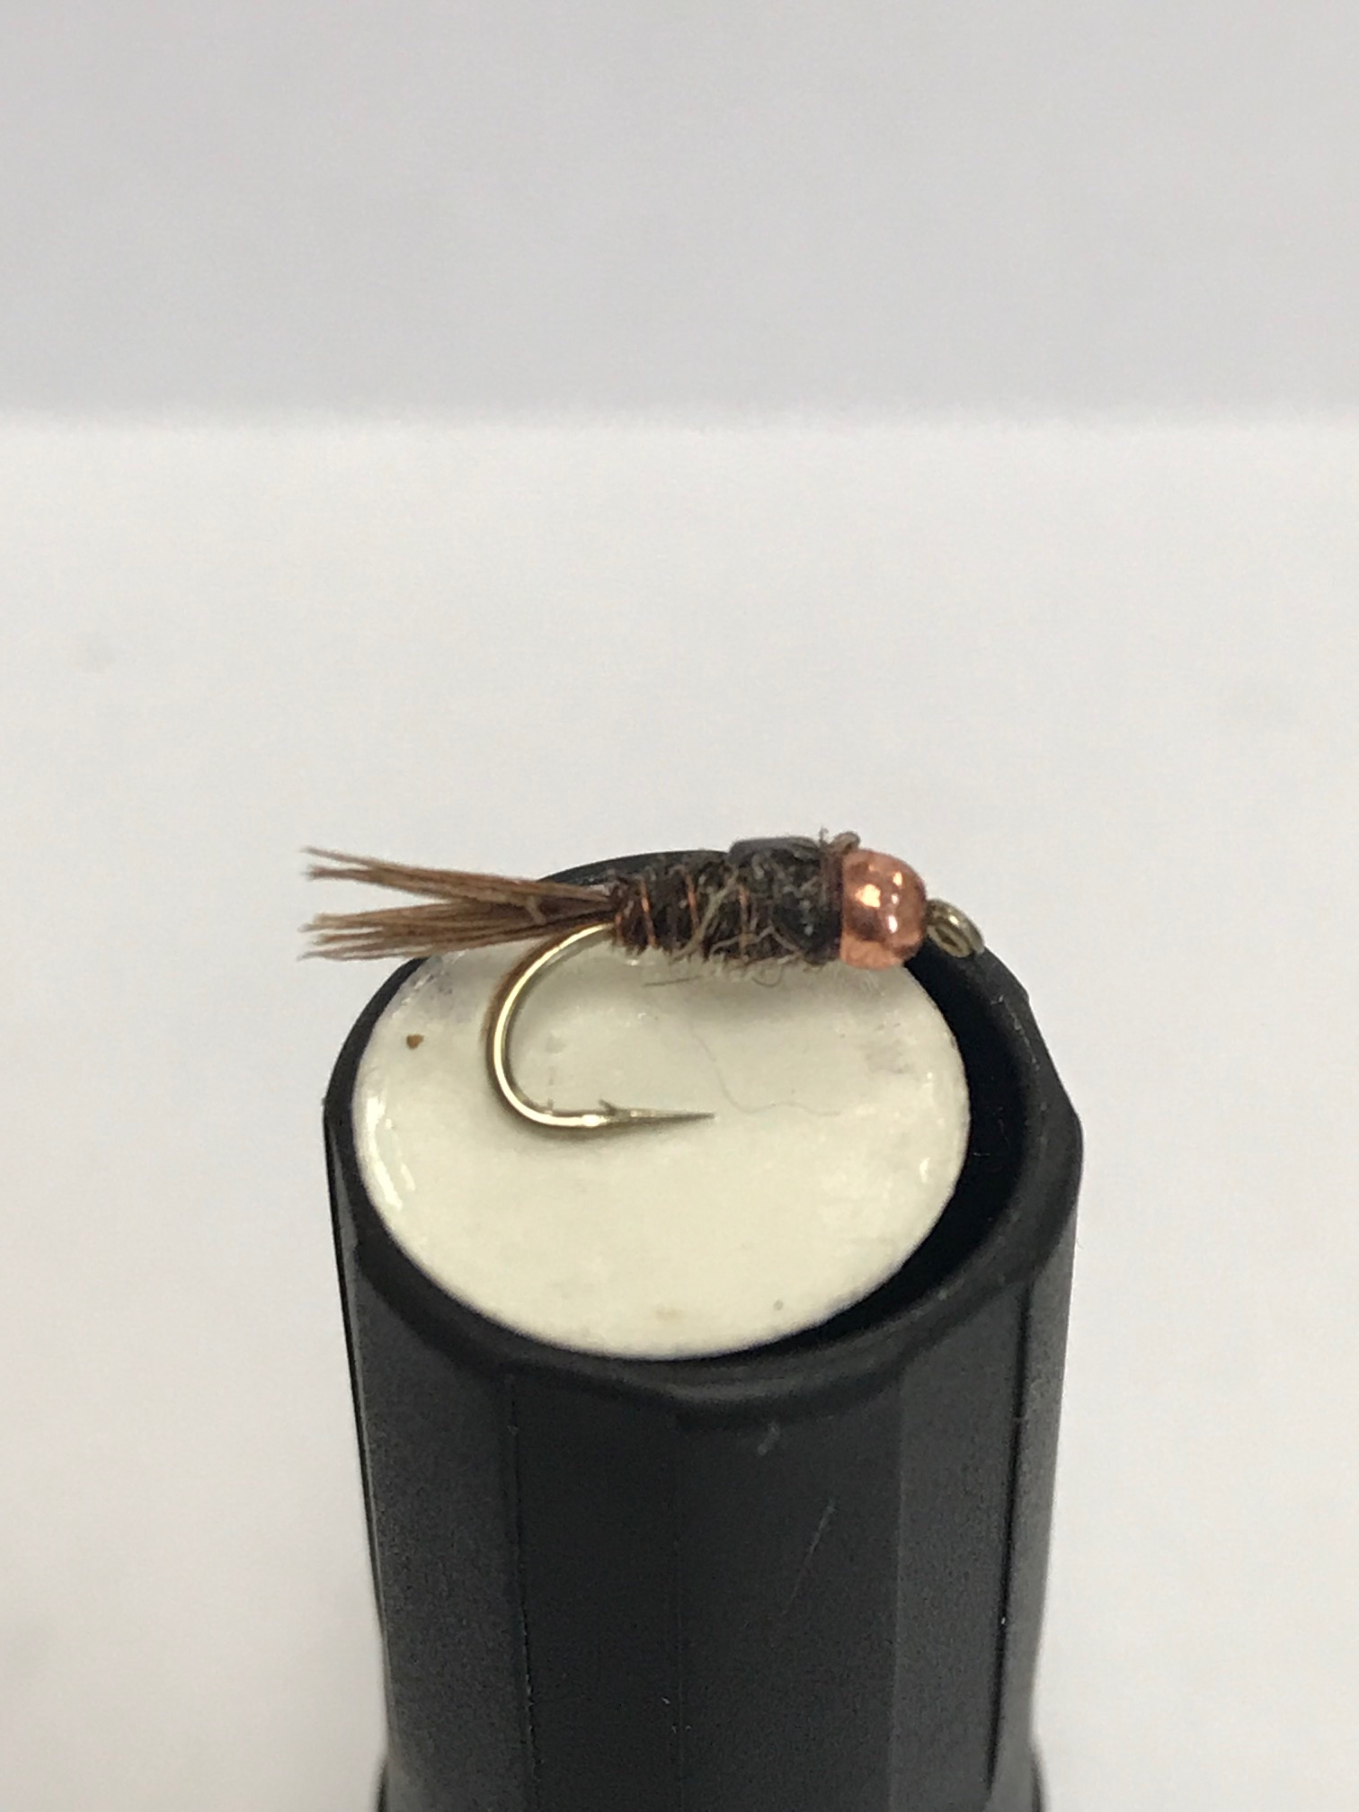
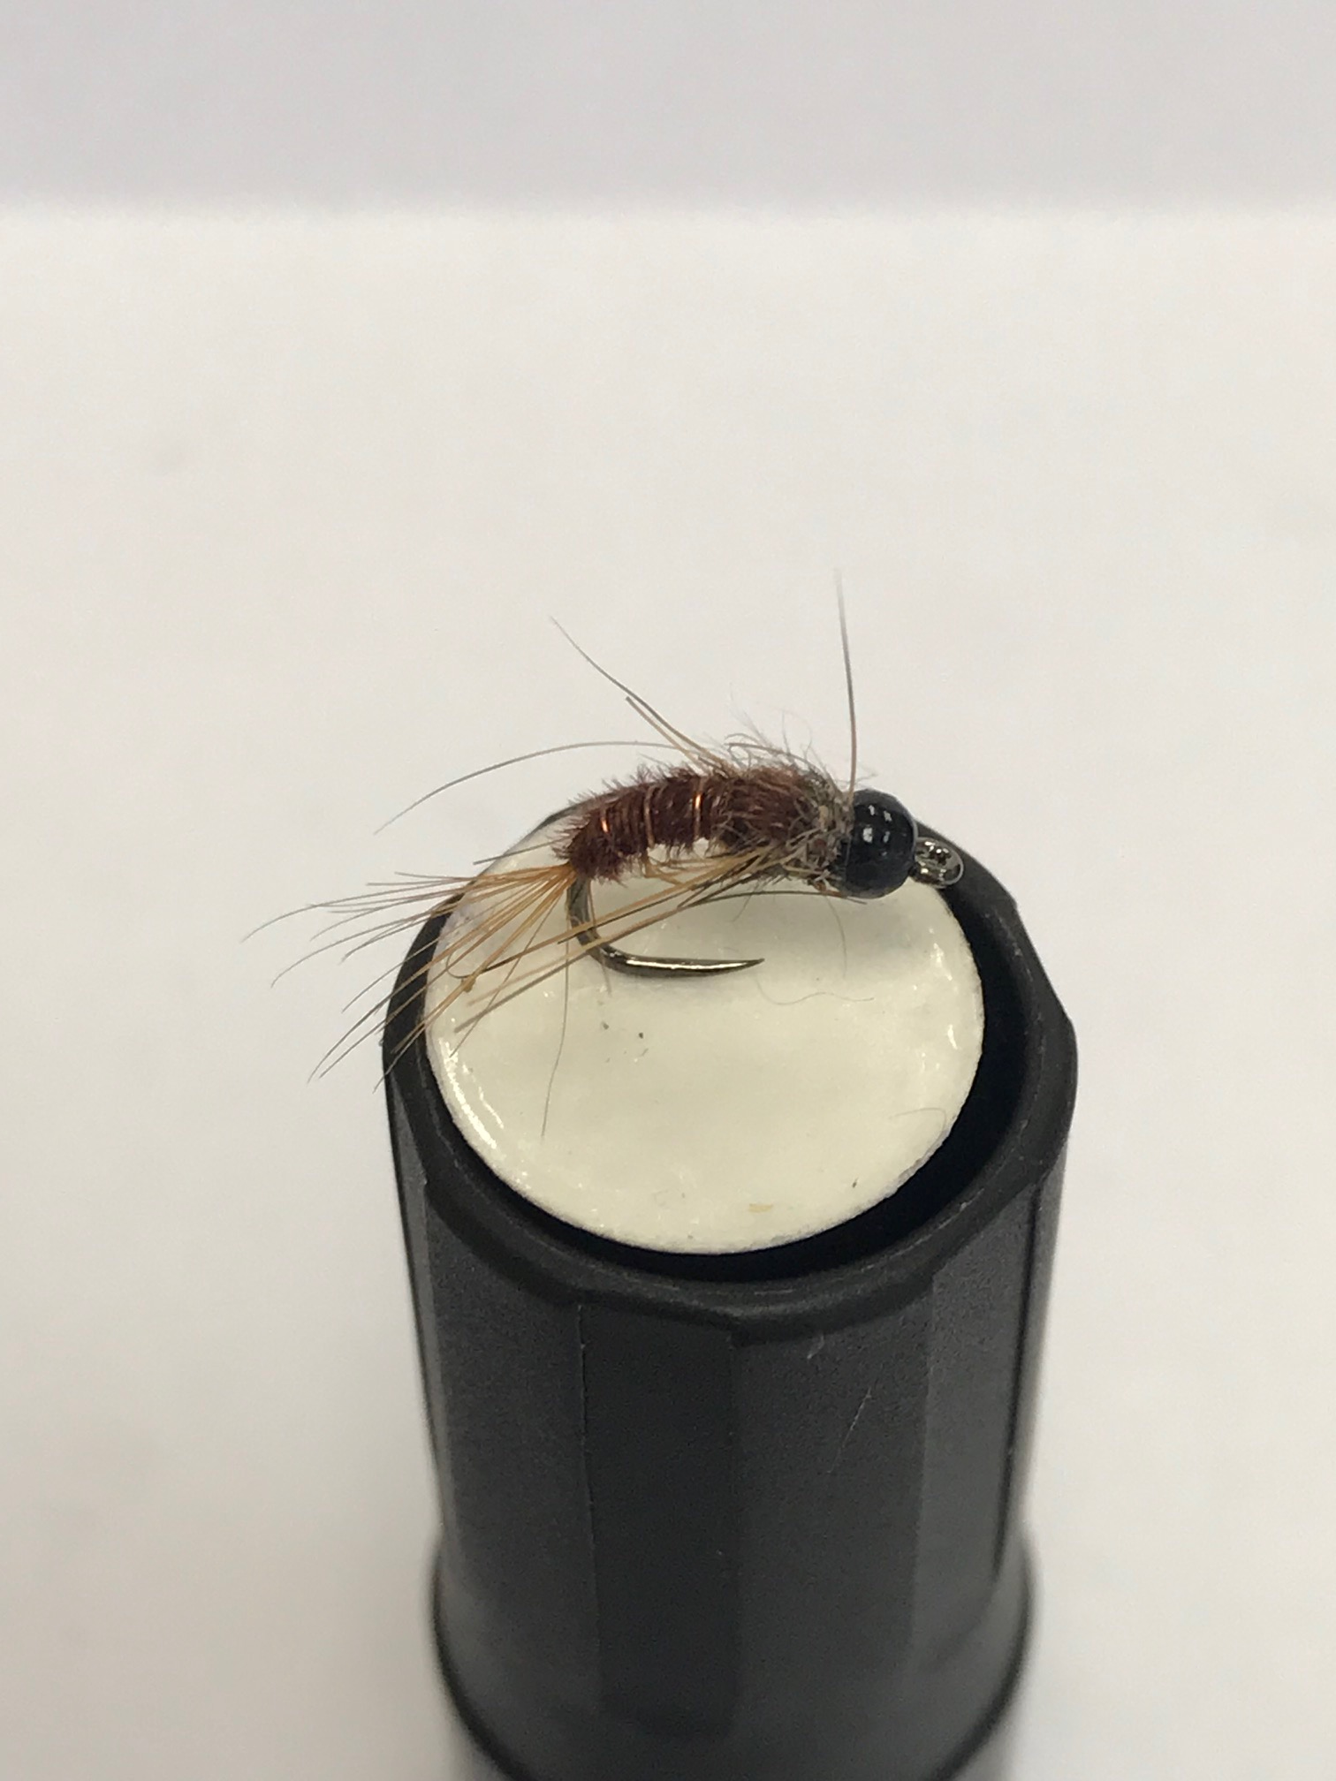
Nymphs - weighted

Slide 19
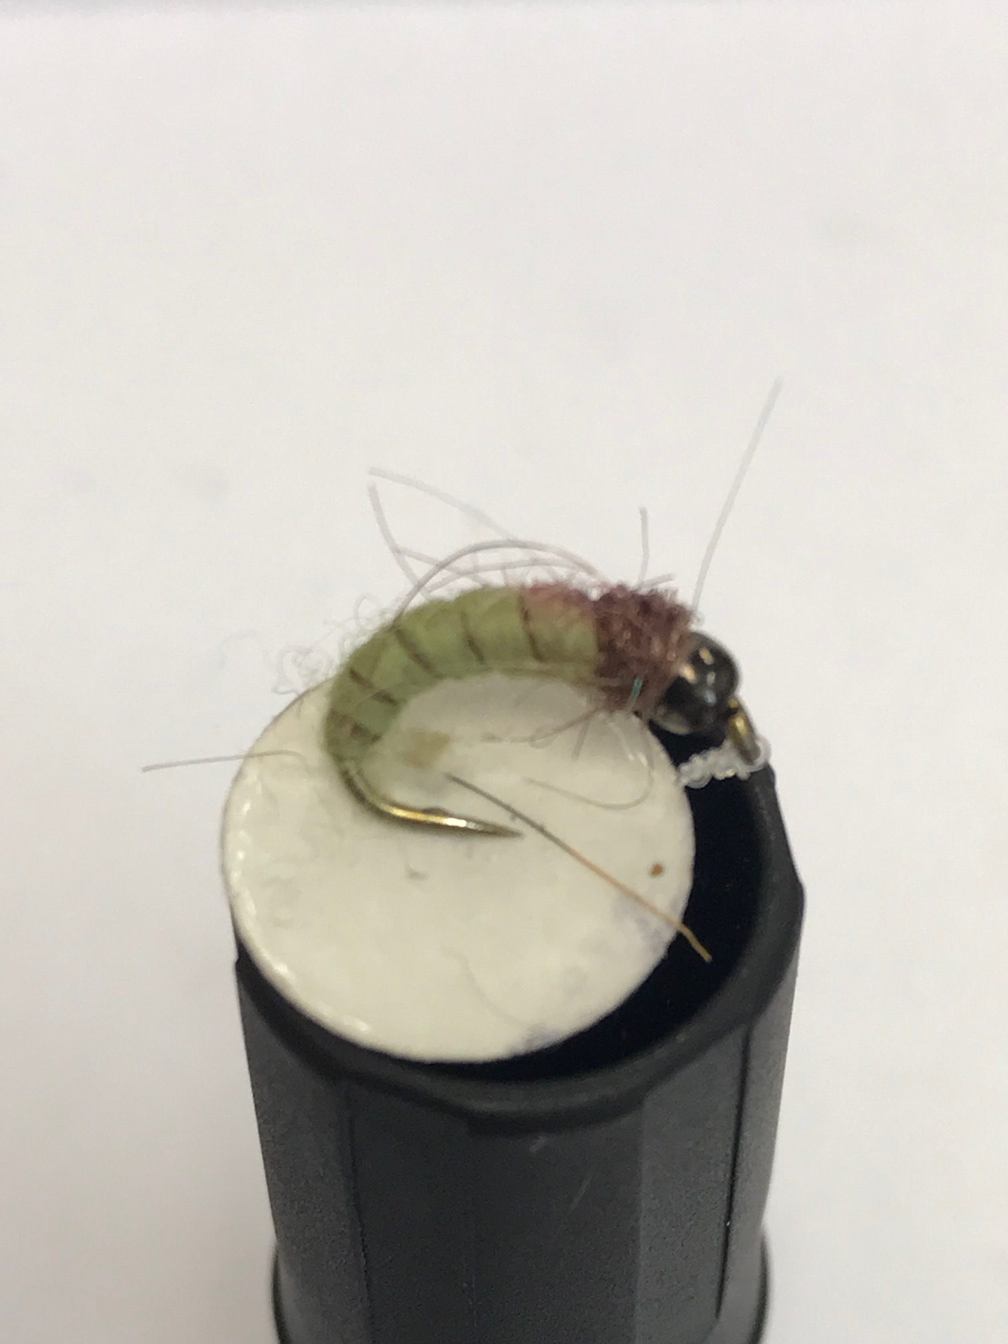
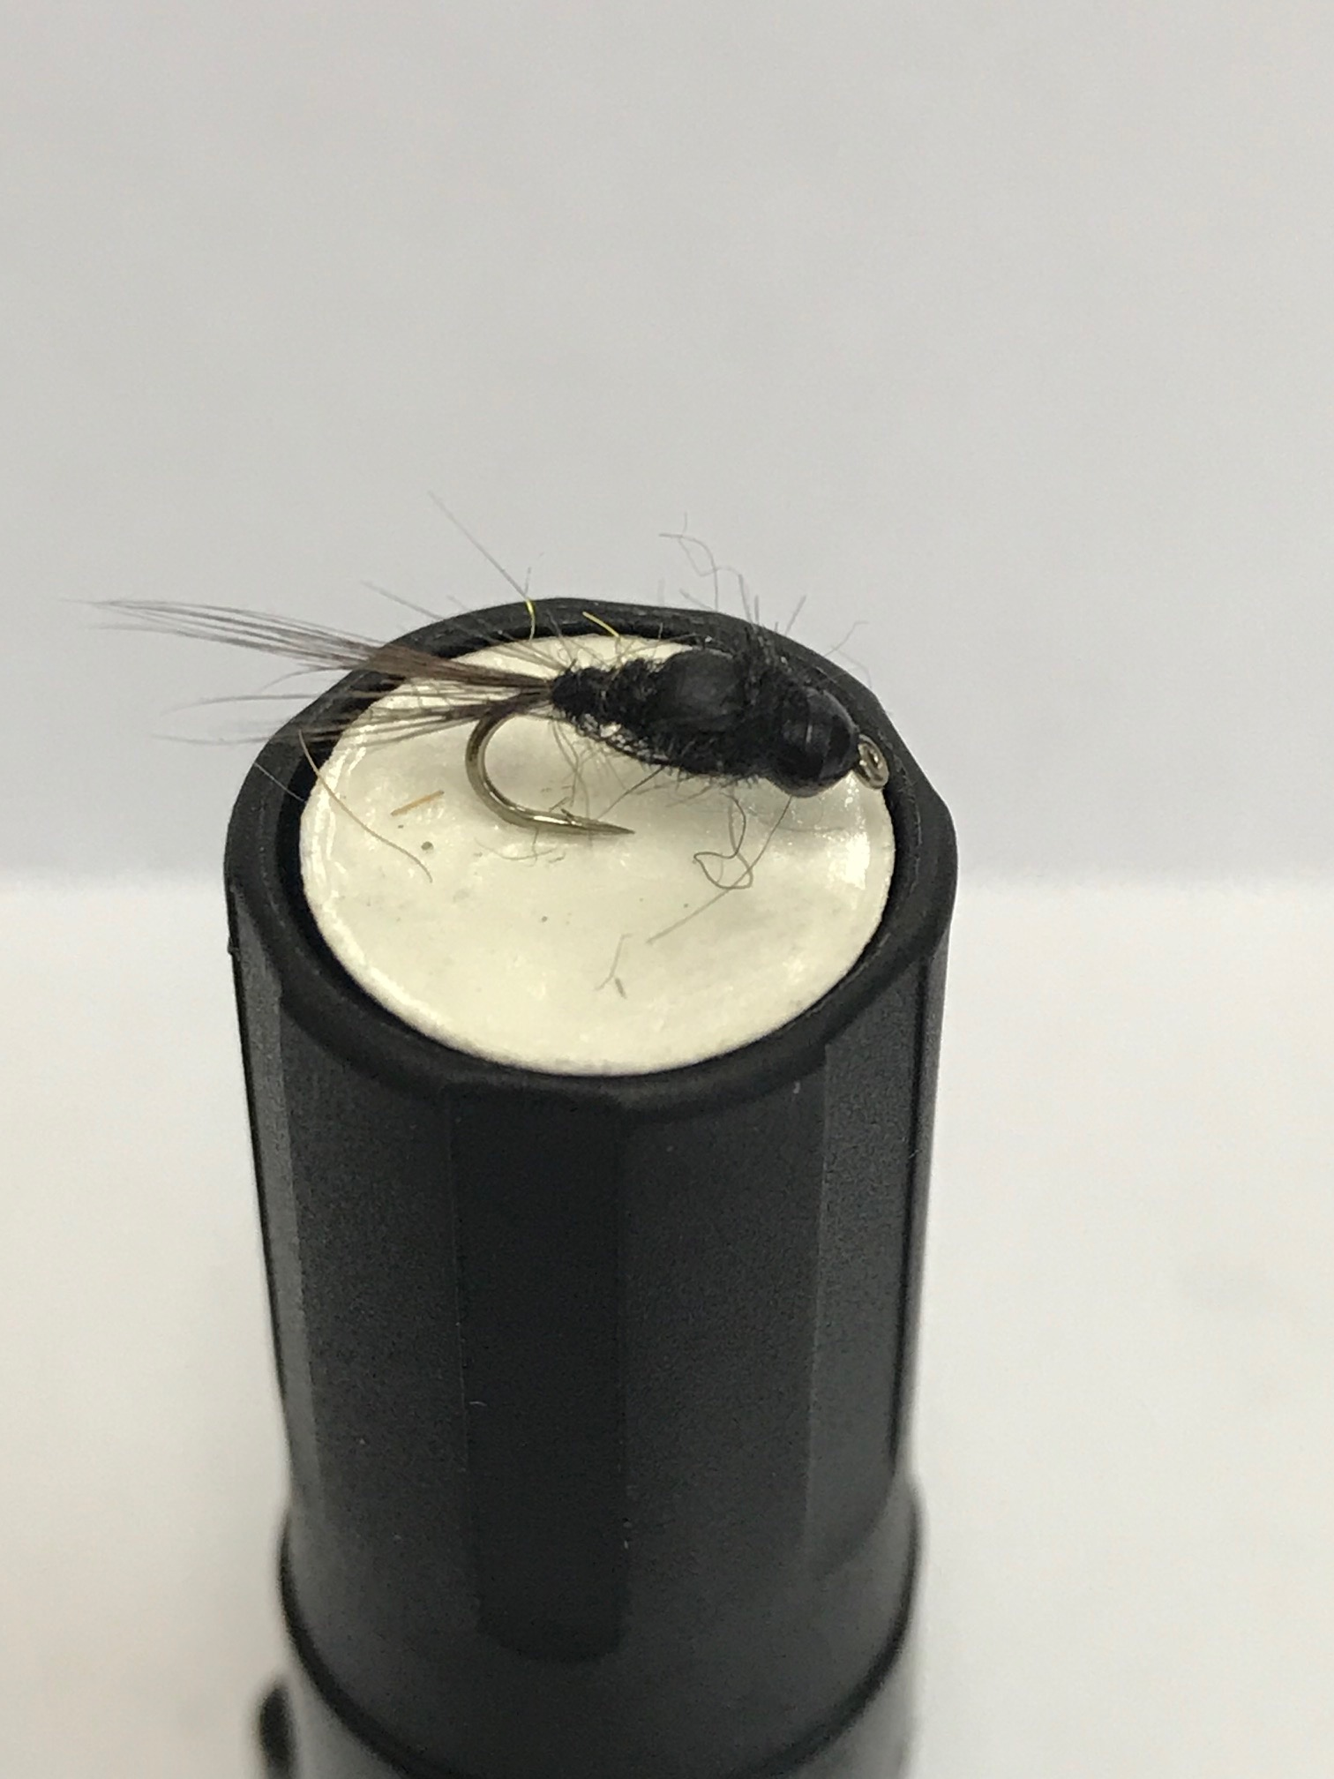
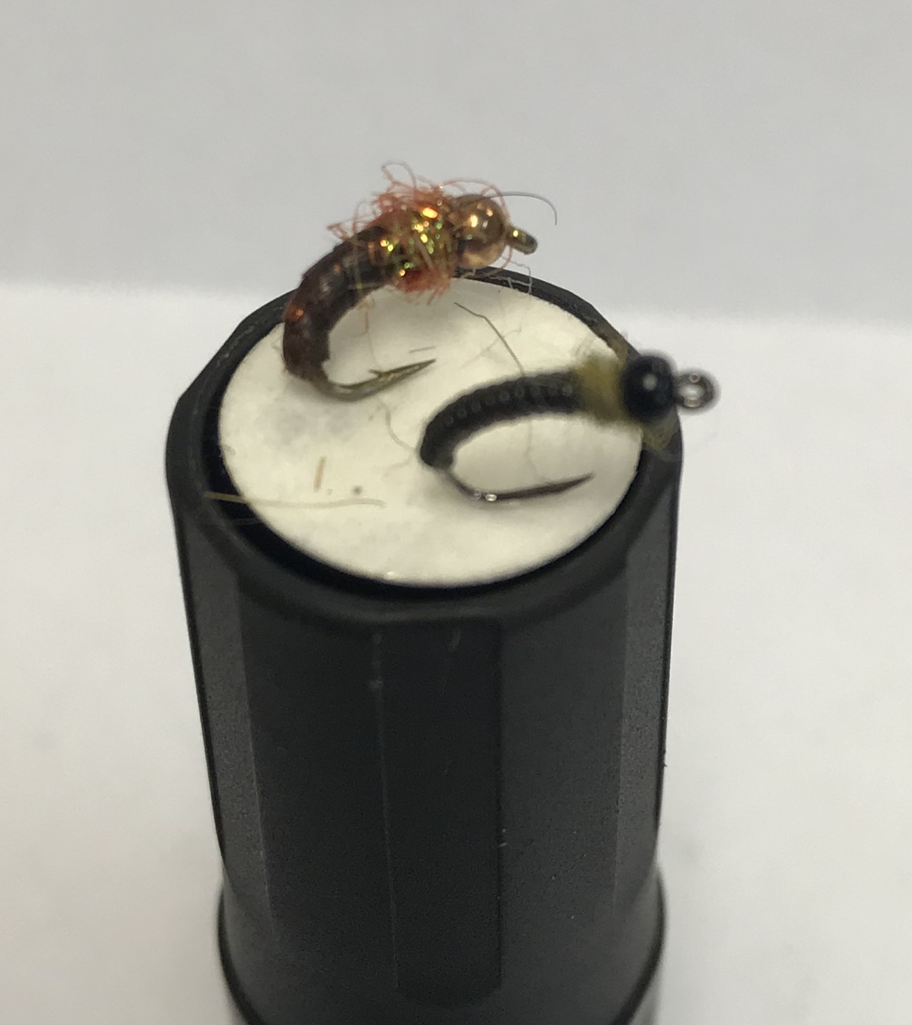
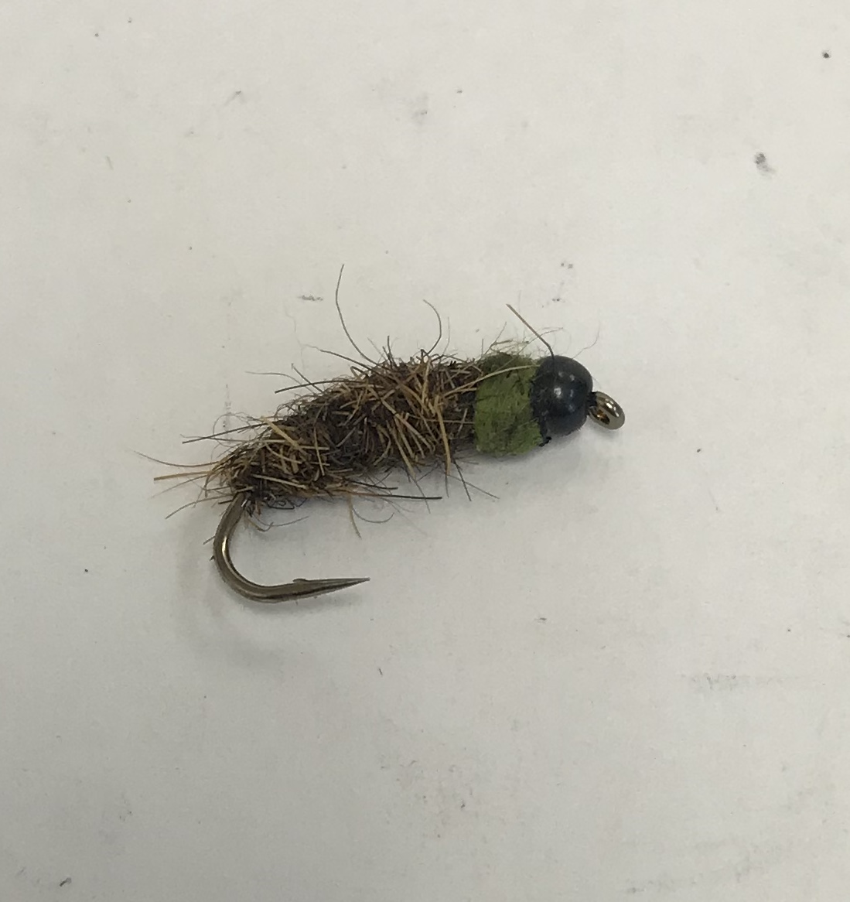
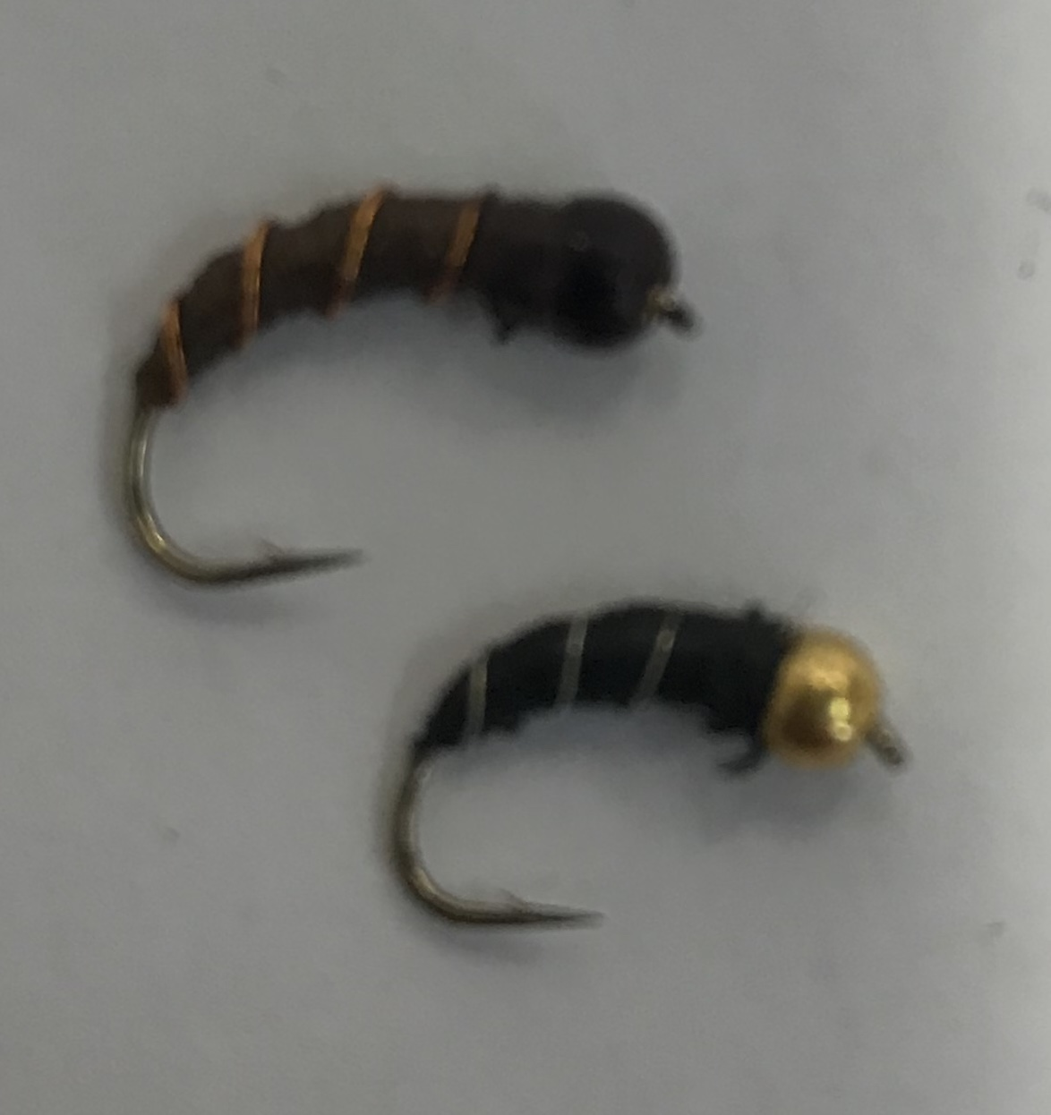
Nymphs – weighted

Slide 20
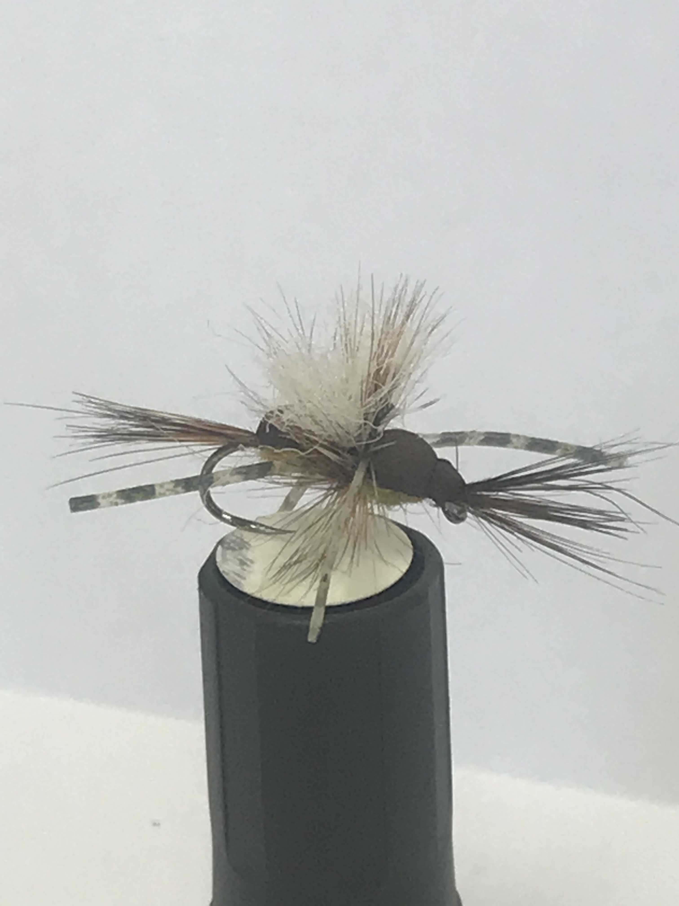
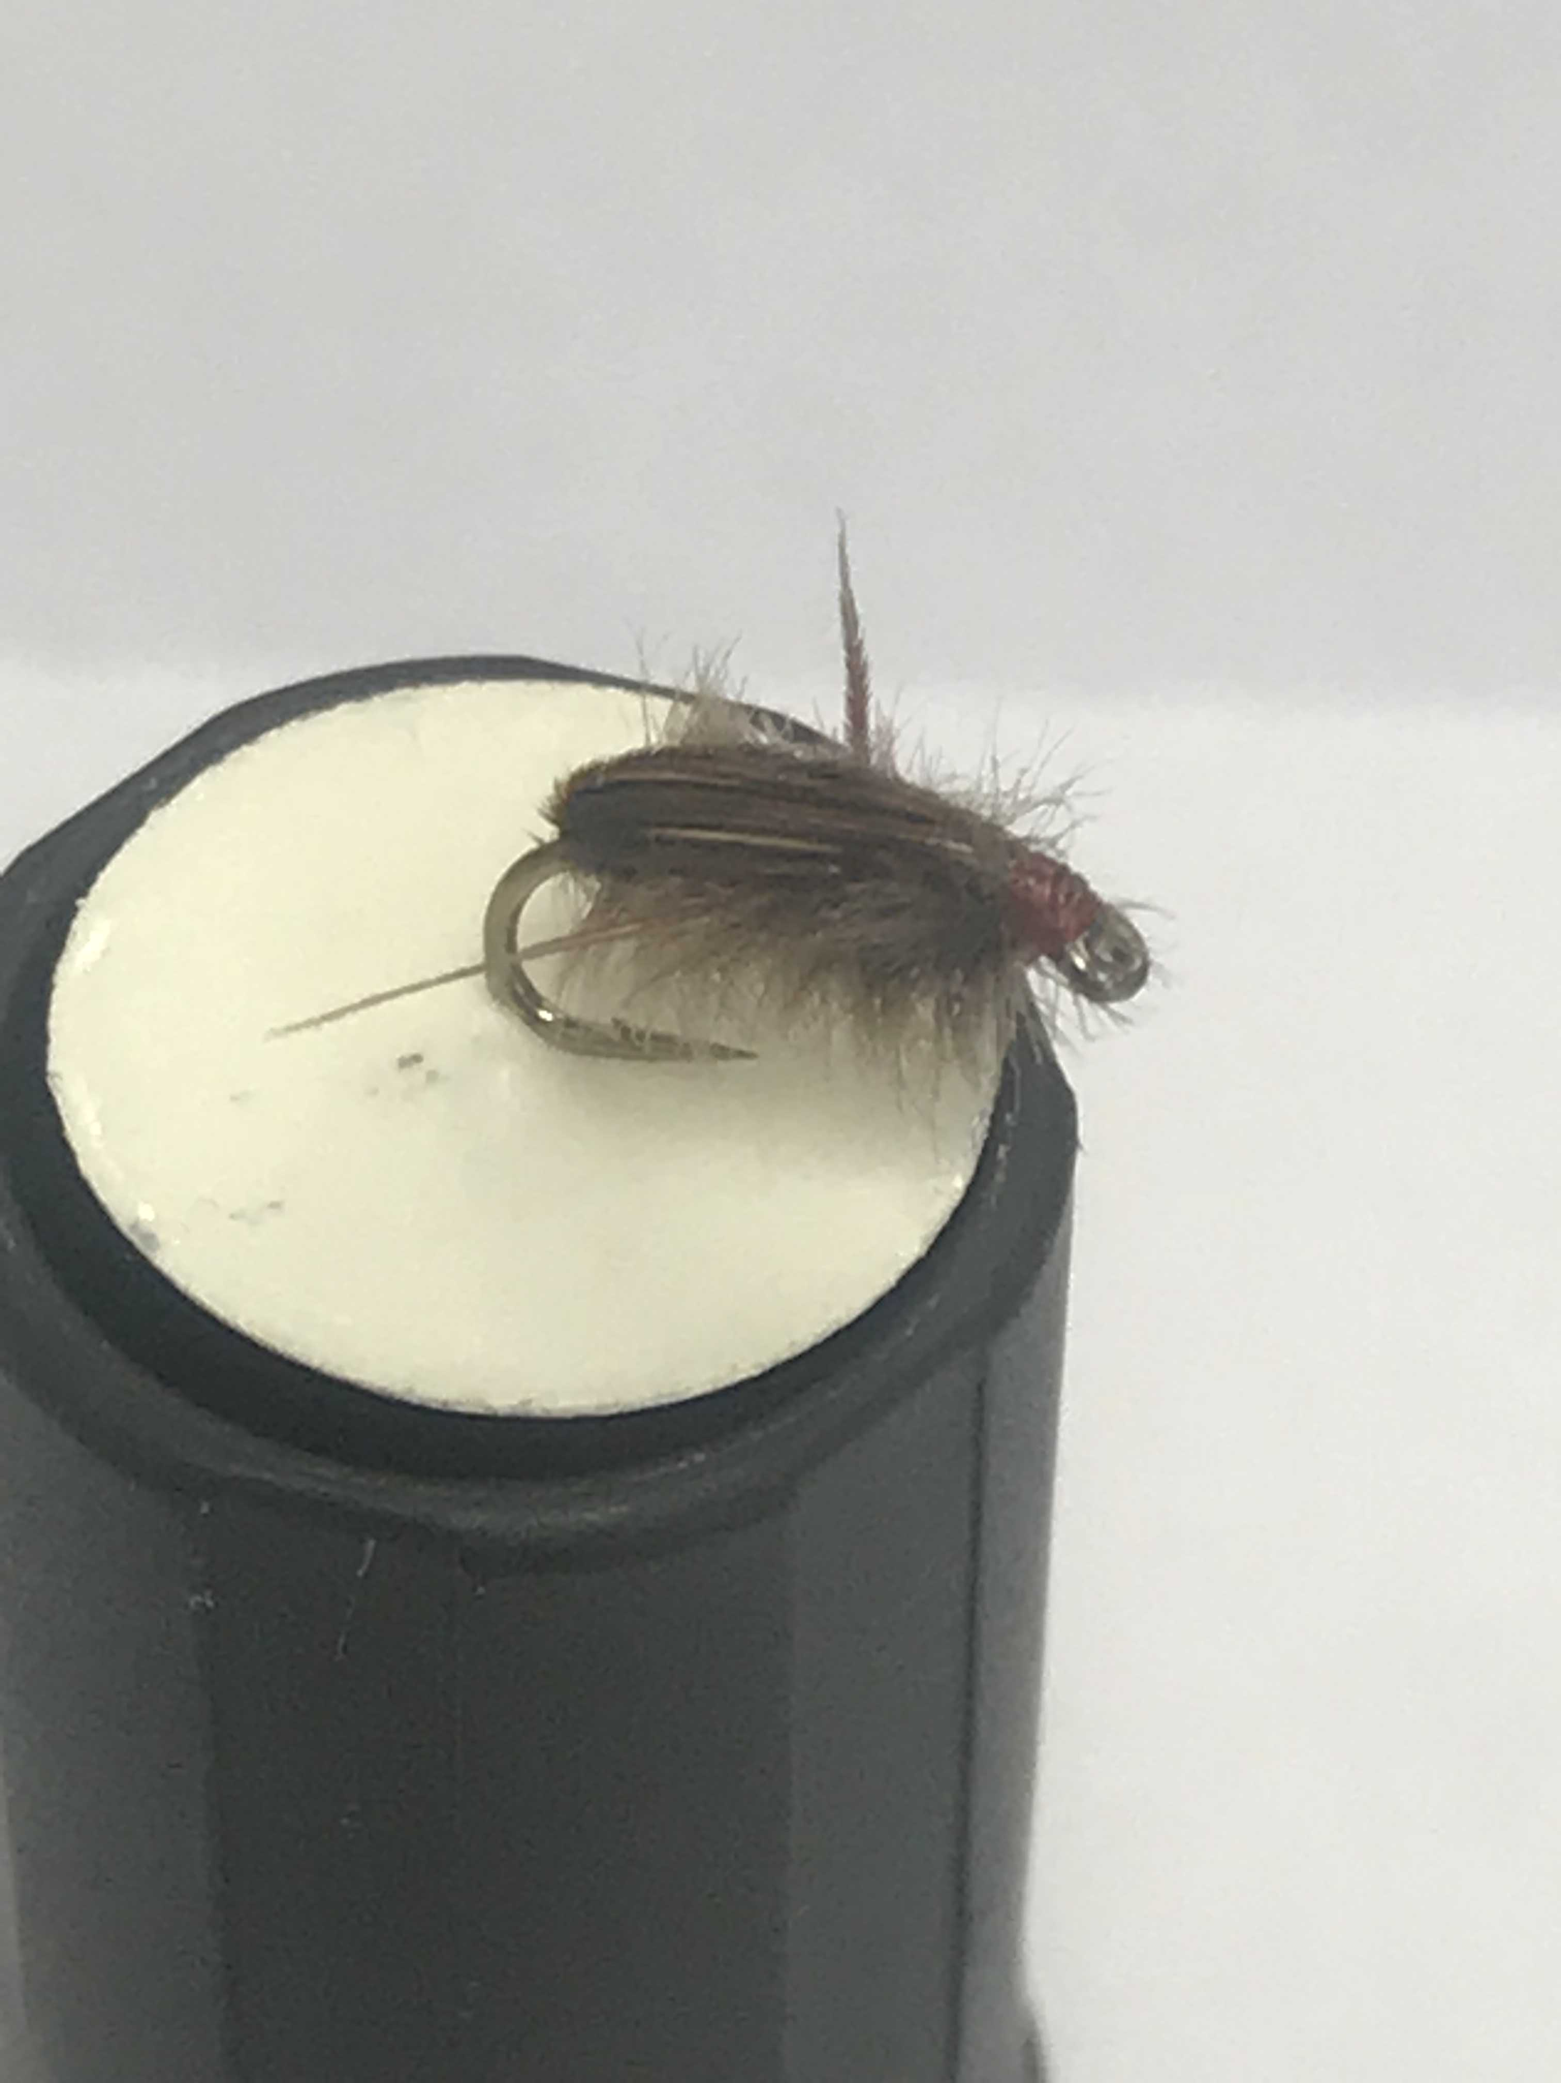
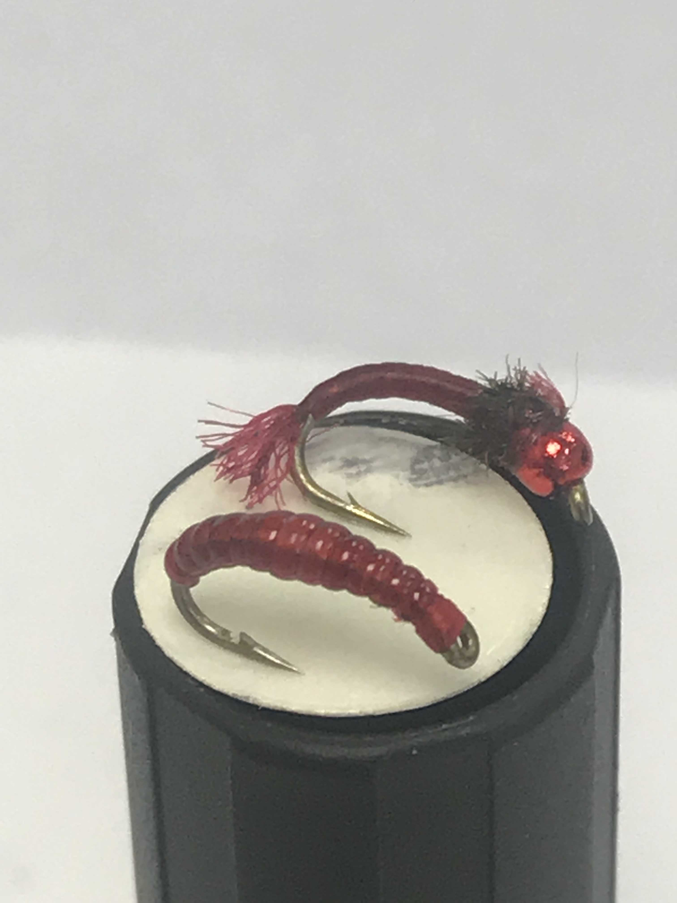
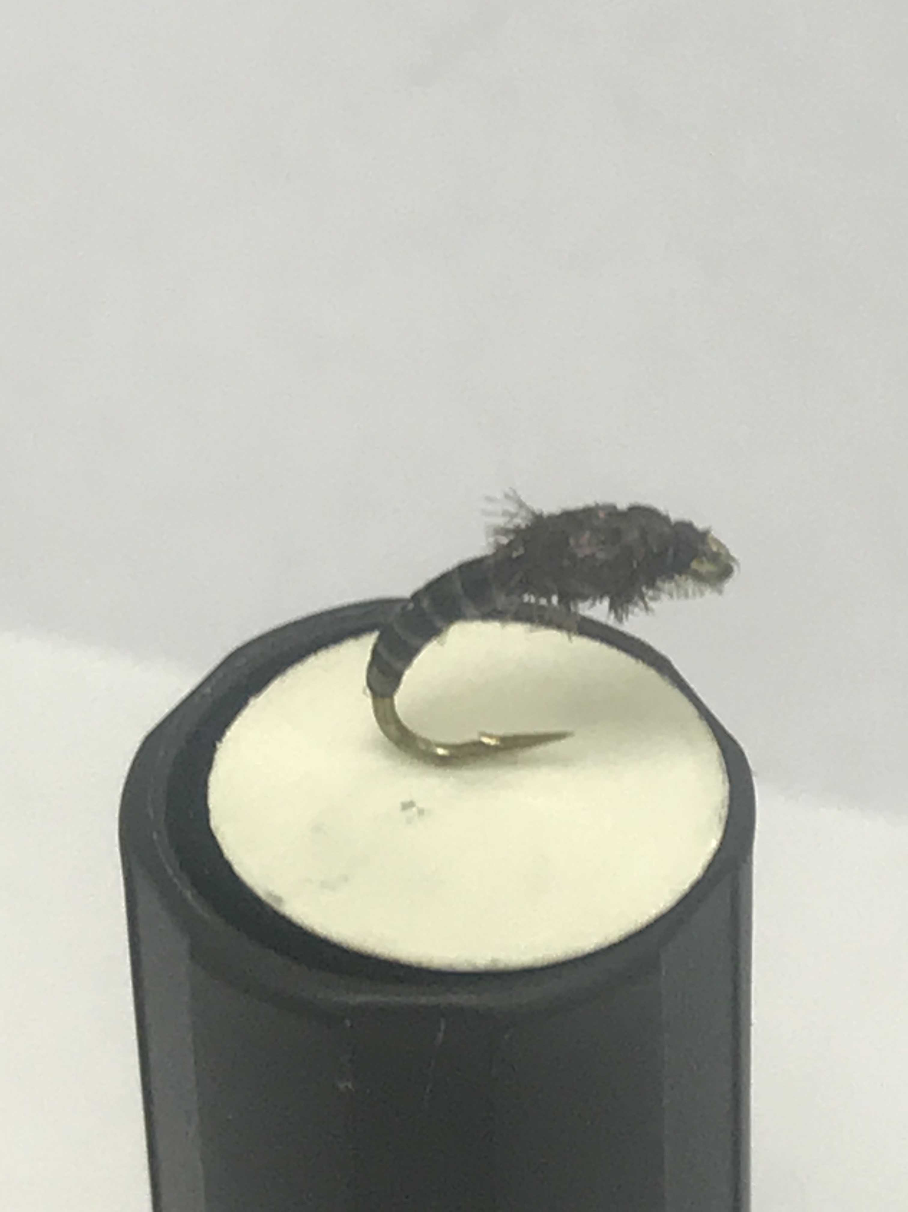
Slackwater, backwater and just ‘cause…
And yes…bloody willow grubs unless a size 18 hares ear is dropped on them…

Slide 21
Techniques and “what the hell are they on?”
1) Rising fish – staying on one spot, not moving much from side to side or back and forward
Head and shoulders rise = duns invariably
Bulges no fish seen or just a nib/fin pricking surface = emerging nymphs
2) Rising fish – several of them, side to side up and down… they are everywhere! Probably just one fish
Just a sip, a dimple each time = spinners flat on surface
Head seen.. and another.. and another! = adult spinners
3) Rising fish – moving up the edge of shallow run…
Tail seen, occasional swirl = grubbing in the stones
May take a dry but nose is in the mud and stones

Slide 22
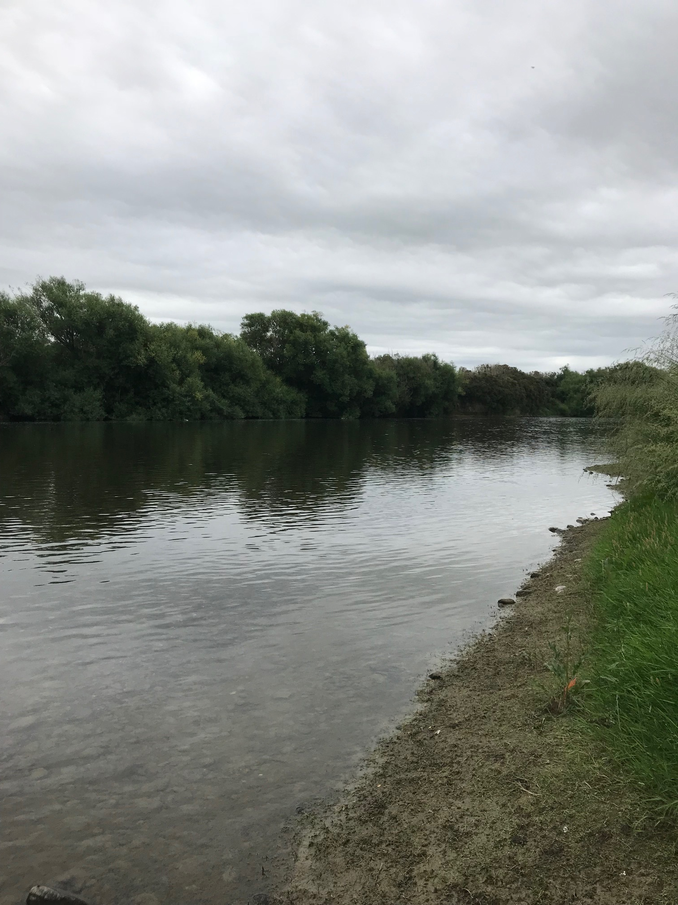
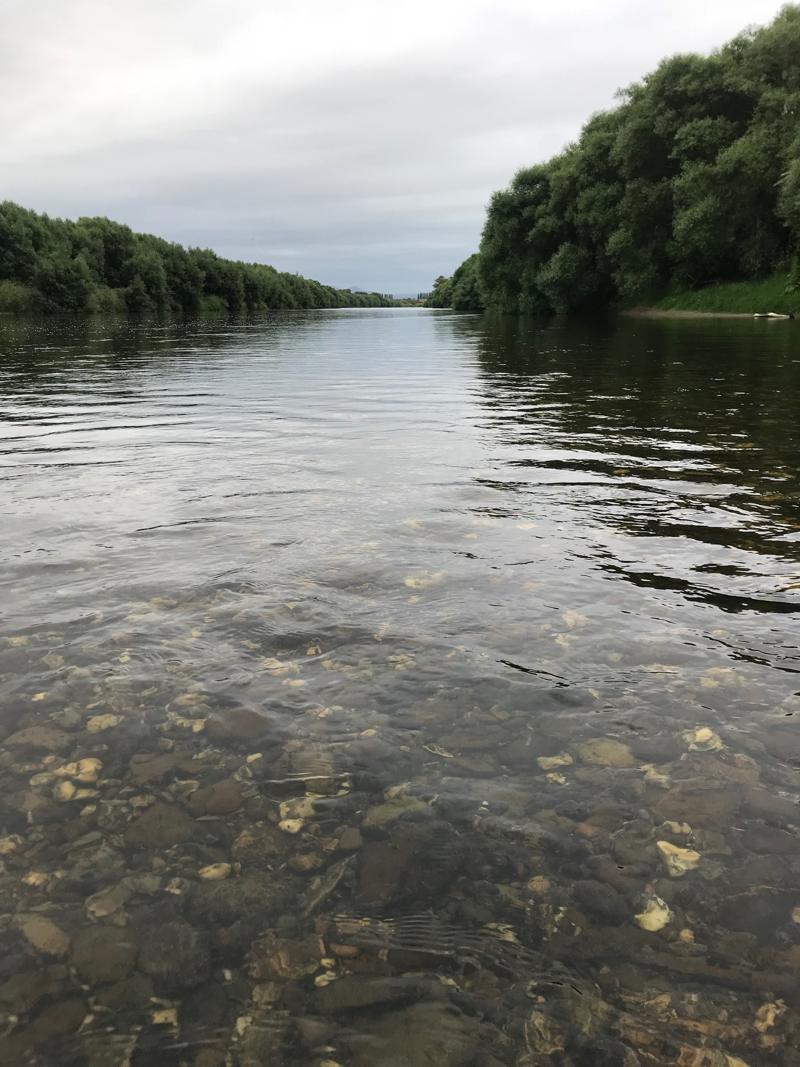

Slide 23
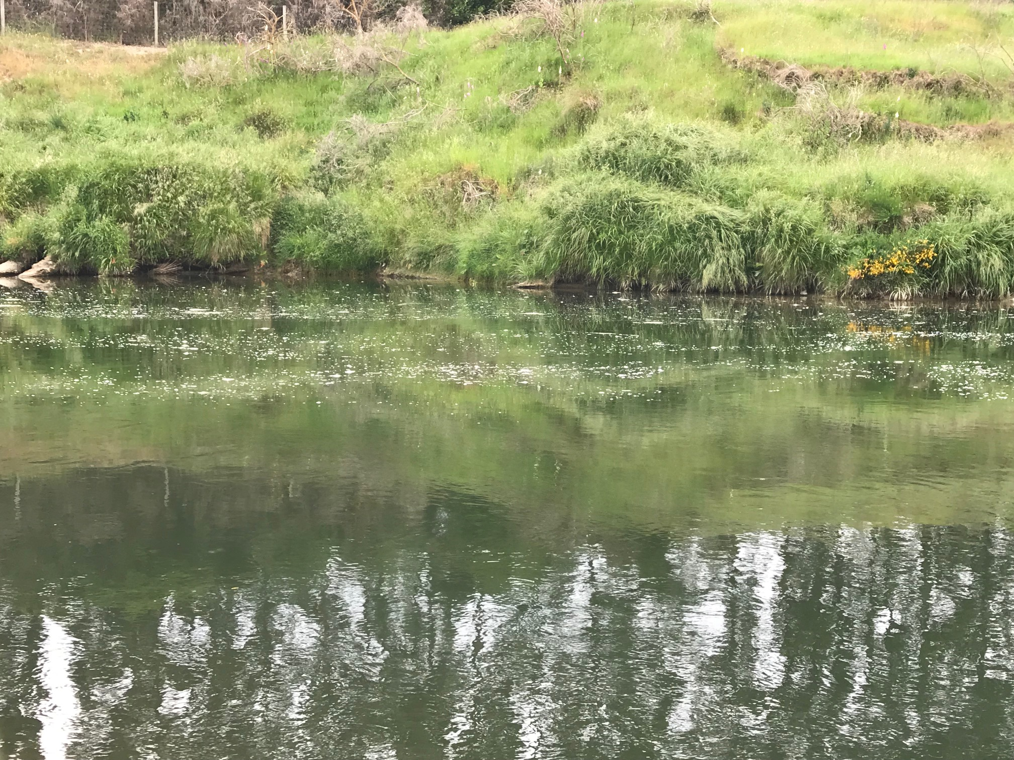

Slide 25
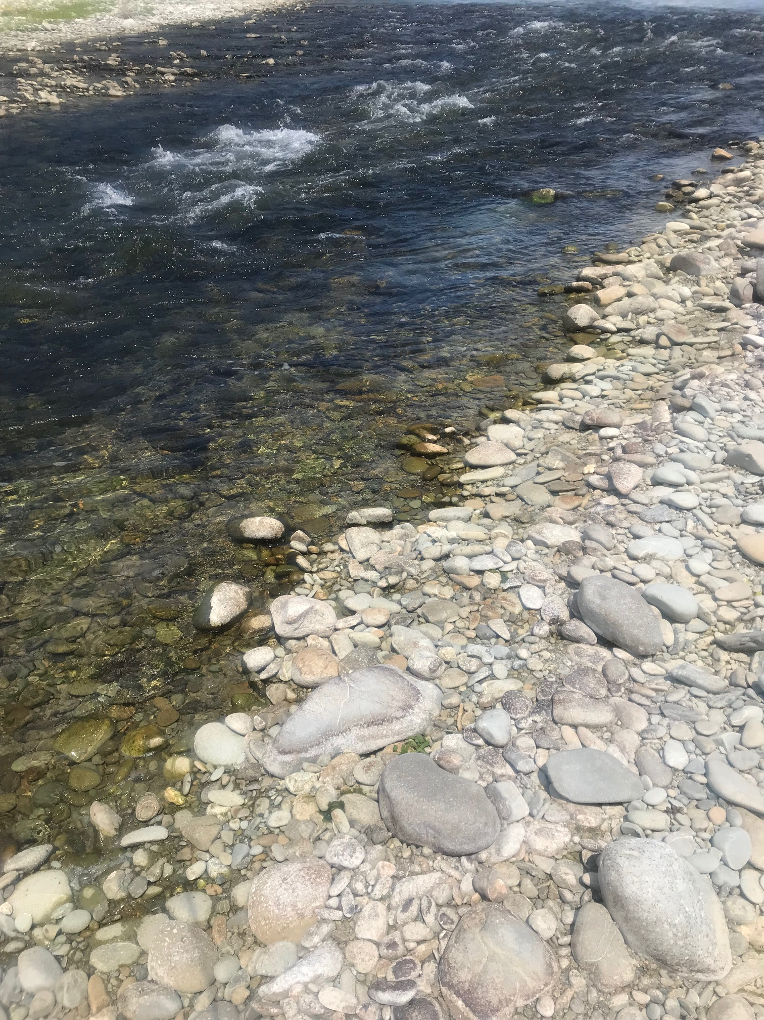
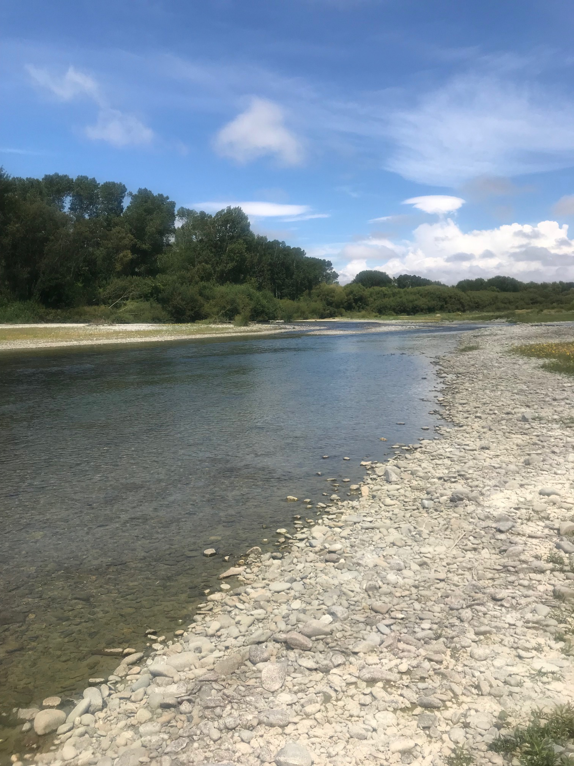

Slide 26
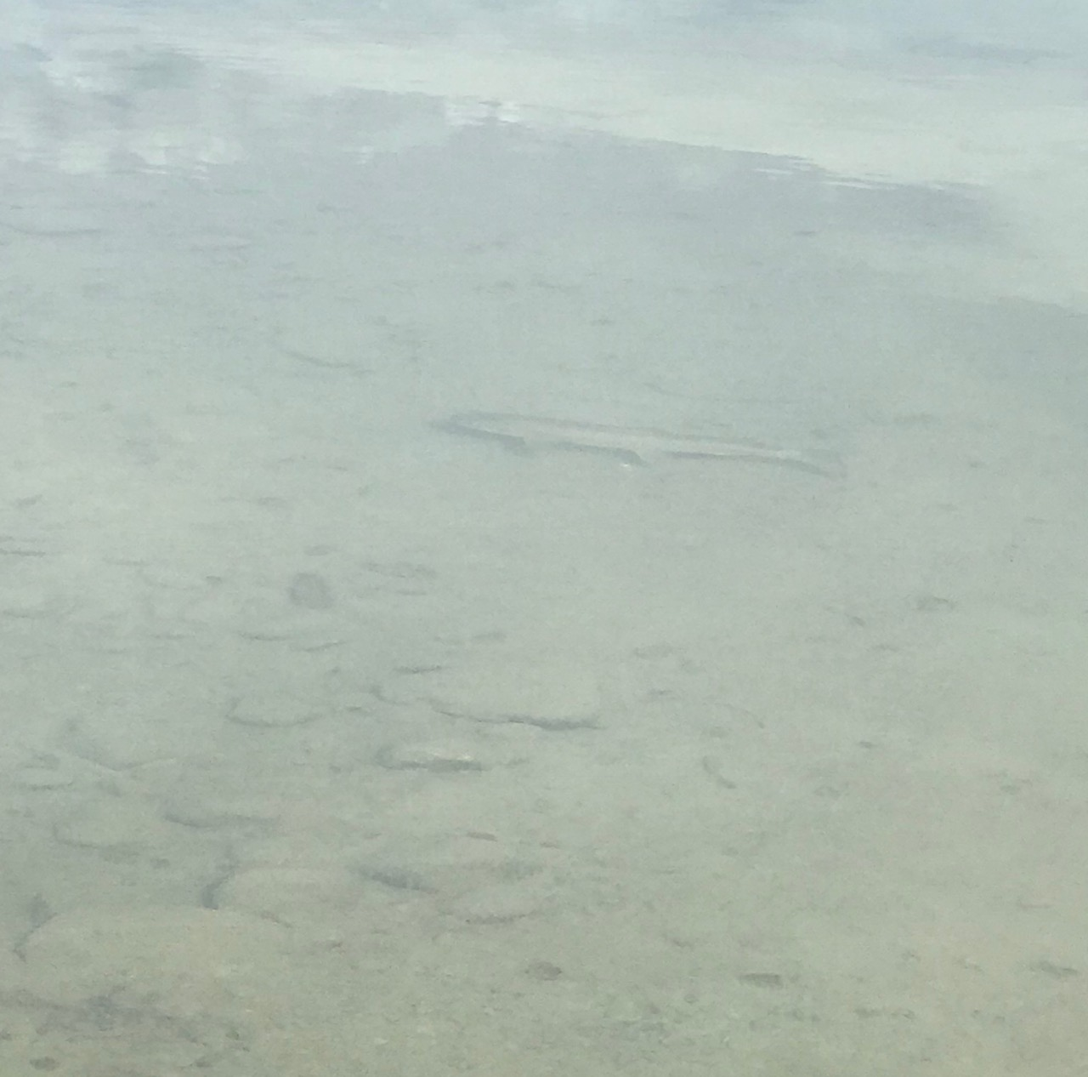

Slide 27
THE END

